Slide 1

USABILITY TESTING AND PLAY-TESTING: A SCIENTIFIC APPROACH 2.0
Master Class MIGS 2017
Martin Talbot, PhD
December 11th 2017
Notes:
https://ca.linkedin.com/in/martintalbotphd

Slide 2
License
Course Material
Permission to use the course material is hereby granted.
The code is provided "as is” without warranty of any kind.

Slide 3
Qualitative vs. quantitative
User research
Behavioral
research
What people do
Why
&
How to fix
How many
&
How much
Attitudinal
research
What people say
Qualitative
Quantitative
Notes:
https://www.nngroup.com/articles/which-ux-research-methods/

Slide 4
Qualitative vs. quantitative
User research
Behavioral
research
What people do
Qualitative methods are better suited for questions about why or how to fix a problem.
Quantitative methods answer how much and how many types of questions. Quantitative methods help prioritize resources, for example to focus on issues with the biggest impact, compare systems’ performance and measure progress.
Why
&
How to fix
How many
&
How much
Attitudinal
research
What people say
Qualitative
Quantitative
Notes:
https://www.nngroup.com/articles/which-ux-research-methods/

Slide 5
Format and benefits
User research
Small groups (usability research)
5 ≤ n ≤ 16
One-on-one format
Piggyback quantitative research on qualitative research
Insert questionnaires, count things (e.g., task fails or slips)
Larger groups (playtest research)
n ≥ 16
One-to-many Satisfaction, NPS, Self-Determination Surveys
Balancing difficulty
Observation, telemetry and biometric
Benefits
Measure and compare the impact of changes in games in development
Compare a game against other games

Slide 6
Goal of this class
Methodology
Although we will keep the maths simple, the quantity of material we will cover can be challenging
Several different methods
Excel
If we can maintain the pace, by the end of the master class we should all be able to analyze data from studies like this one…

Slide 7


Final lab exercises
Statistics
}
Study A: 11 Participants
SMEQ
SAT
Study A
Week 11
11 Participants
Study B
Week 12
12 Participants
Study C
Week 13
14 Participants
SMEQ
SAT
X 3
SMEQ
SAT
SMEQ
SAT
SMEQ
SAT
NPS
SUS
Notes:
Slips, mistakes, deaths
Wilson N-1 Chi Square methods

Slide 8
Typical process
User research
Study design
Goal
Sampling participants
Methodology and plan
Conducting research
Execution of the plan
Data analysis
Which Statistical methods to use
How to interpret the results

Slide 9
Typical process
User research
Study design
Goal
Sampling participants
Methodology and plan
Conducting research
Execution of the plan
Data analysis
Which Statistical methods to use
How to interpret the results

Slide 10
Usability of services – Menus, store, leaderboard…
Methodology
Method
One-on-one
Thinkaloud protocol
PIP video recording
Task driven – breakdown study into discrete tasks
Task i
Note and count the issues encountered during the task
Note and count errors and slips during the task
Measure task duration
Note task successes or failures
Administer a post-task questionnaire
Administer a post-test questionnaire
Debrief with the participant
Notes:
Morea from techsmith, xsplit, …

Slide 11
Usability of gameplay – Tutorial, mechanics, controls, feedback, …
Methodology
Method
One-on-one or a few participants simultaneously
Thinkaloud protocol when applicable
PIP video recording
More sequential than task driven (e.g., onboarding funnel)
Note and count the issues encountered
Note and count errors and slips
Note time duration of sections
Note failures and successes
Administer a post-milestone questionnaire
Administer a post-test questionnaire
Debrief with the participant
}
Help from telemetry
Notes:
E.g., Easter eggs, weapons, amunitions,..

Slide 12
Playability testing – Balance of difficulty, satisfaction, …
Methodology
Method
Several participants at once
No interaction participant/moderator during playtest
Breakdown by sections or sequential
Section i:
From telemetry data:
Number of non-success
Discoverability
Usage
Duration
Note participants decisions (weapon, updates, paths, combos)
Administer a satisfaction questionnaire
Post-test questionnaire
Debrief with the participant

Slide 13
Sampling participants Design
Representativeness
Participants invited must represent well the population of all players
Use Stratified sampling when sampling needs to be diversified
Randomness
Samples of participants must be selected randomly to avoid bias, but it’s difficult in research. E.g., people who decide to participate in a study has different characteristics than the ones who choose not to
Training
Some background knowledge requirements may be needed, e.g., familiarity with a platform or familiarity with an IP (e.g. DLC), game mechanics…
Notes:
Strat of population: https://explorable.com/stratified-sampling
User research parallel with Heisenberg uncertainty principle
Control for the effect of outside variables

Slide 14
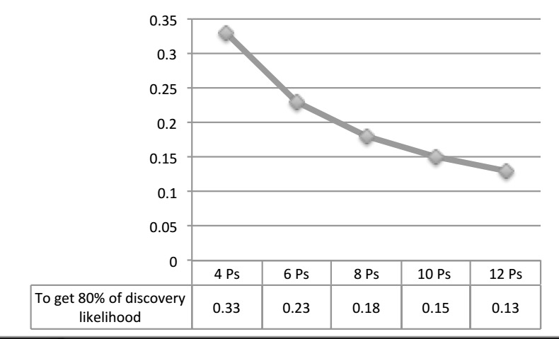
Number of participants Design
Higher precision is expensive
Requires larger groups. Running more participants than needed is wasteful resources
Probabilistic models can help to estimate the sample size of a user research study
User researchers (e.g., Nielsen, 1984) reported that 5 participants suffice to find about 80% of the usability issues
Better 3 tests with 5 participants than one of 15
This implies a discoverability rate of ~28%
Consumer software: 23%
Website: 4%
Videogames: it depends (AAA/Mobile)
Statistical inferences can be made on a small group
Notes:
Nielsen: https://www.nngroup.com/articles/why-you-only-need-to-test-with-5-users/

Slide 15
Experimental design and caveats Design
Experimental design is the process of organizing an experiment properly to get the right type and amount of data to answer research goals
Experimental bias is a key thing to watch for
Satisfaction scores in research lab tend to be inflated
Lab is not an ecological environment to play games
Playtesting can be an exciting experience for participants
Participants pay more attention to details and apply themselves more than normally
Measures of perceived usability, difficulty and satisfaction have dependencies:
Moderator can influence in both directions
Disrupting the gameplay experience (flow) can negatively affect satisfaction
Order effect
Variability on treatment inference must be controlled (e.g., A/B/n testing)
We must watch for sequencial effect (learning, acclimatization)

Slide 16
Randomized block design Design
Test different controller input for combos on same participants
Sequential effect!
4 control schemes to test: A, B, C and D
1 X 2 X 3 X 4 = 24 possible permutations
You would need 24 participants
You may use Latin Square to randomize your design
Seq # | 1 | 2 | 3 | 4
Group 1 | A | B | C | D
Group 2 | B | C | D | A
Group 3 | C | D | A | B
Group 4 | D | A | B | C
Notes:
http://support.minitab.com/en-us/minitab/17/topic-library/modeling-statistics/anova/anova-models/what-are-randomized-block-designs-and-latin-square-designs/
https://onlinecourses.science.psu.edu/stat503/node/21
http://www.stat.yale.edu/Courses/1997-98/101/expdes.htm

Slide 17
Randomized block design – Problem Design
Example: A developer asks you to test 2 control mappings (c1, c2) to fight 3 types of enemies (e1, e2, e3). Enemies are spawned randomly. Enemies require different sequential interactions of c1 and c2. You are asked to determine which of c1 or c2 is best. How many possible combination pairs do we have?
This experiment has 2 treatments: controls and enemies. Controls and enemies have 2 and 3 levels, respectively
Say you are opting for a repeated measure design, i.e., the same participants are used
How many participants are needed to cover all possible permutations?
9
Combinations | A | B | C | D | E | F
Control schemes | c1 | c1 | c1 | c2 | c2 | c2
Enemies | e1 | e2 | e3 | e1 | e2 | e3
720
Notes:
http://stattrek.com/online-calculator/combinations-permutations.aspx

Slide 18
Randomized block design – Latin Square Design
We can use Latin square to get a balanced fraction of a complete factorial desing
Latin square blocks 2 variables, control and sequence order, while enemy levels are randomized.
As a result, we could invite as few as 6 participants
Seq # | 1 | 2 | 3
c1.a | e1 | e2 | e3
c1.b | e2 | e3 | e1
c1.c | e3 | e1 | e2
Design solution | Part 1 | Part 2
Group 1 | c1.a | c2.a
Group 2 | c1.b | c2.b
Group 3 | c1.c | c2.c
Group 4 | c2.a | c1.a
Group 5 | c2.b | c1.b
Group 6 | c2.c | c1.c
Seq # | 1 | 2 | 3
c2.a | e1 | e2 | e3
c2.b | e2 | e3 | e1
c2.c | e3 | e1 | e2
Notes:
http://support.minitab.com/en-us/minitab/17/topic-library/modeling-statistics/anova/anova-models/what-are-randomized-block-designs-and-latin-square-designs/
https://onlinecourses.science.psu.edu/stat503/node/21
http://www.stat.yale.edu/Courses/1997-98/101/expdes.htm

Slide 19
Latin Square – Exercise Design
You are asked to rank 4 different enemies (A,B,C and D) by levels of difficulty. You know that enemies will be spawned randomly. You are concerned about the presentation order because you anticipate some learning effect. That is, the first enemy will always be harder to defeat than the last one.
How many participants would you need to invite in order to test all possible combinations?
Build a Latin Square matrix to determine a presentation order of the study and the lowest number of participants you can invite.

Slide 20
Standard Questionnaires
Standard questionnaires are:
Better than ad hoc homegrown questionnaires
Supported by psychometric qualification measures
There are all sorts of dynamics in play when a human being interacts with a questionnaire (e.g., priming, polarity, wording…)
Support scientific generalization
Ideal for repeated measures
Cons:
Not always adapted to our needs
Not always free

Slide 21
Psychometric evaluation parameters Questionnaires
Questionnaire developers are expected to report the following measurements to assess the quality of their questionnaires:
Validity
The extend to which it measures what it claims to measure, e.g., Pearson correlation coefficient or Factor analysis
Reliability
Measurement of internal consistency in responses, e.g., Cronbach’s alpha
Sensitivity
The extend to which a questionnaire can measure a difference between two treatments when there is one, i.e., minimum sample size needed to get statistical significance when comparing two treatments

Slide 22
n-point Likert scale – Accuracy Questionnaires
Likert scale is the most used approach to scaling responses in questionnaires
They are affirmative or negative sentences followed by Likert options
Typical 5-point Likert scale options look like this:
Strongly disagree
Disagree
Neither disagree nor agree
Agree
Strongly agree

Slide 23
Usability Questionnaires
The most popular standardized questionnaires designed to assess participants’ satisfaction with a game
Two types of usability questionnaires
Post-task:
Administered immediately after a task
Measure the satisfaction with the perceived usability of the task
Post-study:
Administered after having used the game, just before debriefing or other discussions
Measure the holistic satisfaction with the perceived usability of the system or game

Slide 24
Usability – Post study questionnaires Questionnaires
Questionnaire for User Interaction Satisfaction (QUIS)
by Chin et al., 1988
license required: University of Mariland $750 USD
Software Usability Measurement Inventory (SUMI)
by Kirokowski and Corbett, 1993; McSweeney, 1992
license required: University College Cork between €650 and €1300
Post-study System Usability questionnaire (PSSUQ)
by Lewis, 1990
no license required: open to all
Software Usability Scale (SUS)
by Brooke, 1996
no license required: open to all

Slide 25
Usability – Post study questionnaires Questionnaires
Questionnaire for User Interaction Satisfaction (QUIS)
by Chin et al., 1988
license required: University of Mariland $750 USD
Software Usability Measurement Inventory (SUMI)
by Kirokowski and Corbett, 1993; McSweeney, 1992
license required: University College Cork between €650 and €1300
Post-study System Usability questionnaire (PSSUQ)
by Lewis, 1990
no license required: open to all
Software Usability Scale (SUS)
by Brooke, 1996
no license required: open to all
Most used
Highest efficiency
Very effective
Notes:
QUIS and SUMI are localized in many languages.

Slide 26
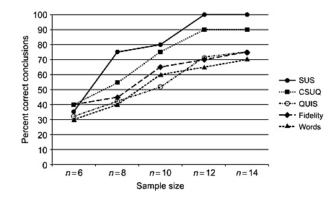
System usability scale (SUS) – Psychometric assessment Questionnaires
Relative sensitivity of 5 questionnaires (Tullis and Stetson, 2004)
SUS outperforms
12 participants reached 100% of correctness
Notes:
http://citeseerx.ist.psu.edu/viewdoc/download?doi=10.1.1.396.3677&rep=rep1&type=pdf

Slide 27
SUS – Questions Questionnaires
I think that I would like to use this system frequently.
I found the system unnecessarily complex.
I thought the system was easy to use.
I think that I would need the support of a technical person to be able to use this system.
I found the various functions in this system were well integrated.
I thought there was too much inconsistency in this system.
I would imagine that most people would learn to use this system very quickly.
I found the system very cumbersome to use.
I felt very confident using the system.
I needed to learn a lot of things before I could get going with this system.
Introduction text in the Notes Page section
Notes:
Introduction text to the survey:
This questionnaire gives you an opportunity to tell us your reaction to the system/game you used. To as great an extent as possible, think about all the tasks that you have done with the game/system, while you anwer these questions. Please read each statement and indicate how strongly you agree or disagree with the statement. Provide immediate response to each question rather than thinking too much about them. After you have compted this questionnaire, I’ll go over your anwers with you to make sure I understand all of your responses. Thank you!
https://www.usability.gov/how-to-and-tools/resources/templates/system-usability-scale-sus.html

Slide 28
SUS – Game version Questionnaires
I think that I would like to use this system game frequently.
I found the system game unnecessarily complex.
I thought the system game was easy to use.
I think that I would need the support of a technical person to be able to use this system game.
I found the various functions in this system game were well integrated.
I thought there was too much inconsistency in this system game.
I would imagine that most people would learn to use this system game very quickly.
I found the system game very cumbersome to use.
I felt very confident using the system game.
I needed to learn a lot of things before I could get going with this system game.

Slide 29
SUS – Game version Questionnaires
I think that I would like to use this game frequently.
I found the game unnecessarily complex.
I thought the game was easy to use.
I think that I would need the support of a technical person to be able to use this game.
I found the various functions in this game were well integrated.
I thought there was too much inconsistency in this game.
I would imagine that most people would learn to use this game very quickly.
I found the game very cumbersome to use.
I felt very confident using the game.
I needed to learn a lot of things before I could get going with this game.

Slide 30
SUS – Two polarities Questionnaires
I think that I would like to use this game frequently.
I found the game unnecessarily complex.
I thought the game was easy to use.
I think that I would need the support of a technical person to be able to use this game.
I found the various functions in this game were well integrated.
I thought there was too much inconsistency in this game.
I would imagine that most people would learn to use this game very quickly.
I found the game very cumbersome to use.
I felt very confident using the game.
I needed to learn a lot of things before I could get going with this game.

Slide 31
SUS – Two dimensions Questionnaires
Usable dimension: 8 questions
Learnable dimension: 2 questions
I think that I would like to use this game frequently.
I found the game unnecessarily complex.
I thought the game was easy to use.
I think that I would need the support of a technical person to be able to use this game.
I found the various functions in this game were well integrated.
I thought there was too much inconsistency in this game.
I would imagine that most people would learn to use this game very quickly.
I found the game very cumbersome to use.
I felt very confident using the game.
I needed to learn a lot of things before I could get going with this game.

Slide 32
SUS – Likert-scale to numerical values Questionnaires
Assign numerical values to options:
Strongly disagree = 0
Disagree = 1
Neither disagree nor agree = 2
Agree = 3
Strongly agree = 4
Positive polarity questions
Multiply numerical values by 2.5, i.e., value * 2.5
Negative polarity questions
Subtract the numerical value from 4 and then multiply by 2.5, i.e., (4 – value) * 2.5
A perfect SUS score is 100
Select the center point when a participant cannot answer a question or did not answer a question
Notes:
Learn about the sequence of terms to describe data: nominal, ordinal, interval and ratio
http://www.usablestats.com/lessons/noir

Slide 33
Exercise: SUS Questionnaires
You administered a SUS to participants. What’s her individual SUS score of this participant?
I think that I would like to use this game frequently. Strongly Agree
I found the game unnecessarily complex. Neither disagree nor agree
I thought the game was easy to use. Agree
I think that I would need the support of a technical person to be able to use this game. Disagree
I found the various functions in this game were well integrated. Agree
I thought there was too much inconsistency in this game. Disagree
I would imagine that most people would learn to use this game very quickly. Strongly disagree
I found the game very cumbersome to use. Disagree
I felt very confident using the game. Agree
I needed to learn a lot of things before I could get going with this game. Agree

Slide 34
Exercise solution: SUS Questionnaires
You administered a SUS to participants. What’s her individual SUS score of this participant?
I think that I would like to use this game frequently. Strongly Agree 4 * 2.5
I found the game unnecessarily complex. Neither disagree nor agree (4-2) * 2.5
I thought the game was easy to use. Agree 3 * 2.5
I think that I would need the support of a technical person to be able to use this game. Disagree (4-1) * 2.5
I found the various functions in this game were well integrated. Agree 3 * 2.5
I thought there was too much inconsistency in this game. Disagree (4-1) * 2.5
I would imagine that most people would learn to use this game very quickly. Strongly disagree 0 * 2.5
I found the game very cumbersome to use. Disagree (4-1) * 2.5
I felt very confident using the game. Agree 3 * 2.5
I needed to learn a lot of things before I could get going with this game. Agree (4-3) * 2.5
See: SusExerciseSolution.xlsx
SUS: 62.5

Slide 35
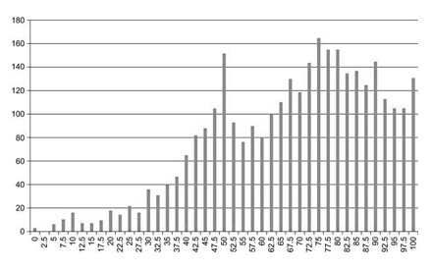
SUS – Score interpretation Questionnaires
Sauro (2011) analyzed 3,187 completed SUS questionnaires. He discovered that the distribution of the individual scores are skewed negatively and not normally distributed
Because of this, we need a table to interpret scores. A table that converts SUS scores from Sauro into percentiles, to which we can compare our SUS scores and find out how usable our system (game) is compared to others

Slide 36
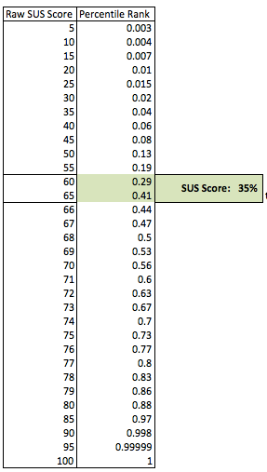
SUS – Score interpretation with percentile rank Questionnaires
The table is shown on the right
So we received a raw SUS score of 62.5. Looking at the percentile rank column, we find the percentage of systems that falls below our score. We see that:
With a SUS score of 62.5 the game has a percentile rank of 35%, MEDIAN(.29, .41), which means that ‘our game’ is considered more usable than 35%, or less usable than 65% of systems tested in a database of 446 studies (over 5000 responses)
Anything with a percentile rank below 50% is poor (SUS scores < 68)
Notes:
Percentile: 100 equal groups into which scores can be divided according to the distribution of all SUS scores
Percentile rank : the percentage of scores in its frequency distribution that are equal to or lower

Slide 37
Be careful with ordinal data (likert-scale type of data)
Statistics
Likert-scale questionnaires produce ordinal data
In 1946 Stevens opposed against doing statistics on ordinal data – Likert-scale responses transformed into numerical values
In contrast, Lords (1953) and several other statisticians have empirically shown that it can be done with one key limitation:
One can say that a score is higher than another, but can’t interpret intervals because the scale may not be linear, e.g., 4/10 vs 2/10 therefore twice better: NOT!
Although it can be assigned to values, the difference between them does not necessarily correspond to the difference in the underlying attribute. For example, the ratio between strongly disagree and disagree may be larger than, say, between neither disagree not agree and agree
Notes:
http://www.mymarketresearchmethods.com/types-of-data-nominal-ordinal-interval-ratio/
http://www.graphpad.com/support/faqid/1089/
http://www.psy.gla.ac.uk/~steve/best/ordinal.html
Quick overview:
Nominal – names (e.g., hockey players’ numbers, UID in games)
Ordinal – represents a rank (e.g., Likert-scale)
Interval – linear distance between data points (e.g., Celcius)
Ratio – has a true zero (e.g, weight, speed)
For different school of thoughts, see:
Stevens in 1946
Lords 1953

Slide 38
Post study system usability questionnaire (PSSUQ) – Version 3 Questionnaires
7-point Likert scale: Strongly Disagree to Strongly Agree and a NA option
Less appropriate than SUS for games and less efficient
Introduction text in the Notes Page section
Overall, I am satisfied with how easy it is to use this system.
It was simple to use this system.
I feel comfortable using this system.
It was easy to learn to use this system.
I believe I became productive quickly using this system.
The system gives error messages that clearly tell me how to fix problems.
Whenever I make a mistake using the system, I recover easily and quickly.
The information (such as online help, on-screen messages, and other documentation) provided with this system is clear.
It is easy to find the information I needed.
The information provided for the system is easy to understand.
The information is effective in helping me complete the tasks and scenarios.
The organization of information on the system screens is clear.
The interface of this system is pleasant.
I like using the interface of this system.
This system has all the functions and capabilities I expect it to have.
Overall, I am satisfied with this system.
Notes:
Post-study System Usability questionnaire
by Lewis, 1990
This questionnaire gives you an opportunity to tell us your reaction to the system you used. Your responses will help us understand what aspects of the system you are particularly concerned about and the aspects that satisfy you. To as great an extent as possible, think about all the tasks that you have done with the system, while you answer these questions. Please read each statement and indicate how strongly you agree or disagree with the statement. If a statement does not apply to you, circle NA. Please write comments to elaborate on your answers. After you have competed this questionnaire, I’ll go over your answers with you to make sure I understand all of your responses. Thanks you.

Slide 39
PSSUQ – Psychometric assessment Questionnaires
System quality
Overall, I am satisfied with how easy it is to use this system.
It was simple to use this system.
I feel comfortable using this system.
It was easy to learn to use this system.
I believe I became productive quickly using this system.
The system gives error messages that clearly tell me how to fix problems.
Information quality
Whenever I make a mistake using the system, I recover easily and quickly.
The information (such as online help, on-screen messages, and other documentation) provided with this system is clear.
It is easy to find the information I needed.
The information provided for the system is easy to understand.
The information is effective in helping me complete the tasks and scenarios.
Interface quality
The organization of information on the system screens is clear.
The interface of this system is pleasant.
I like using the interface of this system.
This system has all the functions and capabilities I expect it to have.
Overall, I am satisfied with this system.
Link to the psychometric evaluation of the PSSUQ
Notes:
https://www.researchgate.net/publication/220302199_Psychometric_Evaluation_of_the_PSSUQ_Using_Data_from_Five_Years_of_Usability_Studies
Gary Perlman has created a website you can view or use a variety of questionnaires (i.e., QUIS, PUEU, NAU, NHE, CSUQ, ASQ, PHUE, PUTQ, USE).
http://garyperlman.com/quest/

Slide 40

Post study questionnaires for VR Questionnaires
NASA Task Load Index (TLX)
by Hart and Staveland, 1988
no license required
Simulator Sickness Questionnaire (SSQ)
by Kennedy et al., 1993
no license required

Slide 41
NASA TLX subcategories Questionnaires
A human factor assessment tool that rates the perceived workload when using a system
The total workload is defined into six subcategories
Developed by the Human Performance Group at NASA
More than three-year development cycle that included more than 40 laboratory simulations.
A two-option questionnaire
Administer part 1 only
Raw TLX score
Individual subcategories can be dropped if not relevant
Increased experimental validity
Administer part 1 and 2 together
Weighted TLX score
Notes:
http://pro.sagepub.com/content/52/19/1522
Scalar invariance: a given measure is interpreted in a conceptually different manner by respondents representing different gender or cultural backgroud. E.g., the contstruct of depression, which we can’t see and only see it’s effect on people. Crying as a measure of depression would not be scalar invariant, because women tend to cry more than men (social background), but are not necessarily more depressed.
Hence, use a within subject design approach

Slide 42
NASA TLX – Implemented version Questionnaires
The HTML + JavaScript implementation file of NASA TLX is available in the NASA TLX Questionnaire folder
Implemented by Keith Vertanen (Michigan Tech University)
Let’s take a look at it in a web browser
To compile results, see file: NASA-TLX calculations.xlsx
Notes:
http://www.keithv.com/software/nasatlx/

Slide 43
Similator Sickness Questionnaire (SSQ) Questionnaires
Used over 1000 sets of data to identify 27 symptoms commonly experienced in VR
4 representative subscores can be found
But we are only interested in 3 (it’s accepted to ignore symptoms questions from the original questionnaire). So we focus on:
Nausea-related sub-score
Oculomotor-related sub-score
Disorientation-related sub-score
SSQ score is the total score of these three subcategories
We must administer the same questionnaire pre- and post-exposure and subtract the pre-score from the post-score
Notes:
ftp://ftp.hitl.washington.edu/pub/publications/r-98-11/node135.html
https://www.twentymilliseconds.com/html/ssq-scoring.html

Slide 44
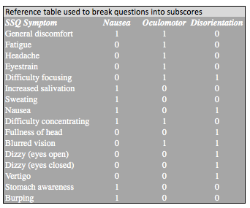
SSQ – Implemented version Questionnaires
Here’s a link to the questionnaire I have implemented in SurveyMonkey.
Let’s take a look at it in Chrome
See file: SSQ calculations.xlsx
Notes:
https://www.surveymonkey.com/r/YQ8TFGQ

Slide 45
Usability – Post task questionnaires Questionnaires
After Scenario Questionnaire (ASQ)
by Lewis 1990, 1991, 1995
Usability Magnitude Estimation (UME)
by McGee, 2003, 2004
Single Ease Question (SEQ)
by Tedesco and Tullis, 2006
Subjective Mental Effort Question (SMEQ)
by Sauro and Dumas, 2009

Slide 46
Usability – Post task questionnaires Questionnaires
After Scenario Questionnaire (ASQ)
by Lewis 1990, 1991, 1995
Usability Magnitude Estimation (UME)
by McGee, 2003, 2004
Single Ease Question (SEQ)
by Tedesco and Tullis, 2006
Subjective Mental Effort Question (SMEQ)
by Sauro and Dumas, 2009
Evidences suggesting SMEQ is more sensitive than SEQ and UME

Slide 47
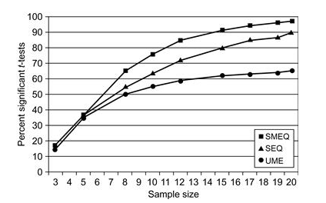
SMEQ – Psychometric assessment Questionnaires
Relative sensitivity of 3 questionnaires (Sauro and Dumas, 2009)
SMEQ was better at picking significant differences between tasks
85% of correctness was reached with 12 participants

Slide 48
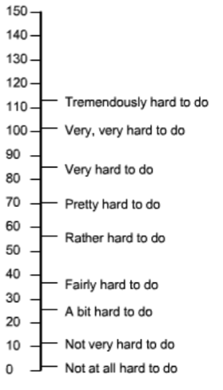
SMEQ – Questions Questionnaires
The scaled labels are psychometrically calibrated against tasks
Participants draw a line through a vertical scale to indicate how much mental effort they had to invest to execute the task: Rate how hard was this task

Slide 49
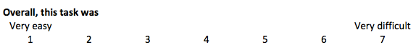
SEQ – Psychometric assessment Questionnaires
7-point Likert scale question
Participants circle a value to indicate how much mental effort they had to invest to execute the task: Rate how easy or hard was this task

Slide 50
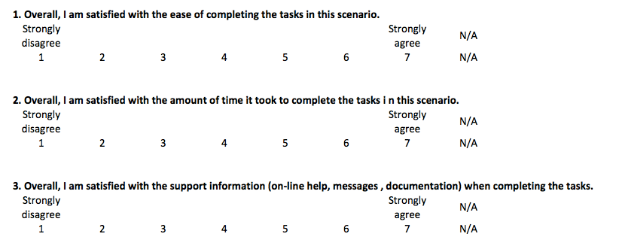
ASQ – Questions Questionnaires
7-point Likert scale question with an N/A option
Participants circle the value that indicates how strongly they agree or disagree with each statement. The average of the three responses produce the ASQ score

Slide 51
UME – Questions Questionnaires
Participants are asked to rate task difficulty relative to a simple baseline task, to which the researcher assigns a value of 10. E.g., a baseline task could be to kill this enemy
Then the participant is asked right after he completed a new task to rate the difficulty of the task she has just finished compared to the baseline task
Note: Some participants have a difficult time understanding the nature of ratio judgments. Concepts such as “twice as difficult” and “one half as difficult” take training and feedback to understand
Notes:
E.g., How difficult was the task you just completed compared to the “Connect to Facebook” task? Higher number indicates a more difficult task

Slide 52
Player satisfaction about gameplay Questionnaires
Attitudinal research
Affective Slider
Net Promoter Score
Player Experience of Need Satisfaction (Rigby and Ryan Przybylski, 2006)
Behavioral research
Balancing difficulty
Measuring Presence in Virtual Environments (Witmer and Singer, 1998)
Game Engagement Questionnaire (Brockmyer et al., 2009)
Social presence in gaming questionnaire (Kort et al. 2007)
GameFlow: A Model for Evaluating Player Enjoyment in Games (Sweetser and Wyeth, 2005 )
Notes:
https://www.amazon.ca/Glued-Games-Video-Draw-Spellbound/dp/0313362246
http://playtestingworkshops.com/assets/pdf/scholarly/Nordin_YDS2014.pdf
Presence: http://webstaff.itn.liu.se/~matco/TNM053/Papers/presence.pdf
PENS: http://selfdeterminationtheory.org/SDT/documents/2006_RyanRigbyPrzybylski_MandE.pdf
Engagement http://faculty.uoit.ca/kapralos/csci5530/Papers/geq.pdf
https://www.researchgate.net/publication/228091680_Digital_Games_as_Social_Presence_Technology_Development_of_the_Social_Presence_in_Gaming_Questionnaire_SPGQ

Slide 53
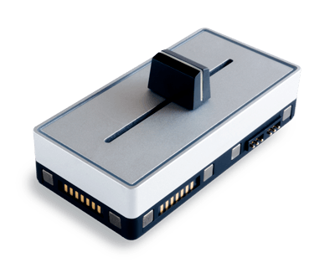
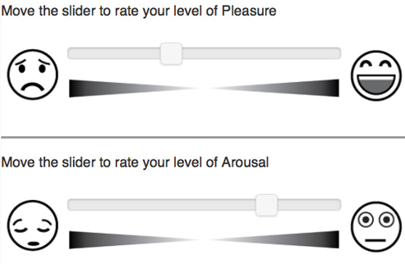
Playability – Affective Slider (post task or post study) Questionnaires
Can be administered at the end of levels or at the end of the study
The Affective sliders do not require written instructions and are displayed using a neutral chromatic palette to avoid bias in ratings due to the emotional connotation of colors.
Please rate the last section of the game you’ve just played using both sliders. Don’t think too much about it, just rate how you felt when you played the chapter.
We can use only this one
Notes:
See article in the Papers folder

Slide 54
Playability – Assessment of difficulty (post task) Questionnaires
Assessment of difficulty with self-reported questionnaires is difficult
Not uncommon in practice to observe participants dying repeatedly and reporting the difficulty being OK for them
Not uncommon in practice to observe participants beating the game with great ease and reporting the difficulty being OK for them
To assess difficulty, it is desirable to use several measures and triangulate the results:
Number of fails
Time taken to beat a level
A questionnaire with a baseline à la UME
Decoding facial expressions and body movements
Biometrics data from electrodermal activity (EDA) or heart rate measurements electromyography (EMG)

Slide 55
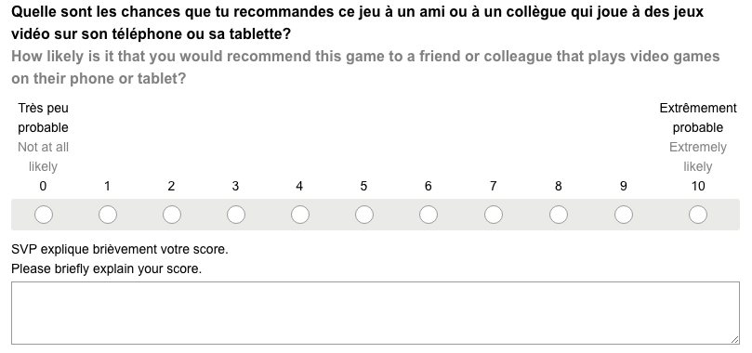
Net Promoter Score (NPS) – Post study Questionnaires
A tool to measure customers’ satisfaction and loyalty to a game. One single question.
ton
Notes:
http://www.medallia.com/net-promoter-score/

Slide 56
NPS – Calculating score Questionnaires
Based on their ratings, respondents are then classified in 3 categories: detractors, passives and promoters.
DETRACTORS are not particularly thrilled by the game. They, with all likelihood, won’t purchase it and could potentially damage the game’s reputation through negative word of mouth.

Slide 57
NPS – Calculating score Questionnaires
Based on their ratings, respondents are then classified in 3 categories: detractors, passives and promoters.
PASSIVES are somewhat satisfied with the game but are not enthusiastic enough about it to promote it. They probably wouldn’t spread any negative word-of-mouth.

Slide 58
NPS – Calculating score Questionnaires
Based on their ratings, respondents are then classified in 3 categories: detractors, passives and promoters.
PROMOTERS love the game. They are the enthusiastic evangelist who recommends the game to other potential buyers.

Slide 59
NPS – Calculating score Questionnaires
NPS = % of promoters - % of detractors
Example: you administered the NPS to 10 participants and get:
5 promoters
2 neutrals
3 detractors
NPS = 5/10 – 3/10 = 2/10 = 20
The NPS is between -100 and 100; a higher score is desirable
NPS are often low: a low median of 16 was found in a study on 400 companies across 28 industries (Reichheld, 2003)
Evidences from research shows a strong correlation between the ratio of promoters and the success of a product or company
Notes:
https://hbr.org/2003/12/the-one-number-you-need-to-grow

Slide 60
Exercise: NPS Questionnaires
You received these results from a NPS questionnaire you administered to 10 participants.
Calculate the NPS score.
P0: 8
P1: 9
P2: 7
P3: 9
P4: 6
P5: 10
P6: 5
P7: 8
P8: 7
P9: 6

Slide 61
Exercise solution: NPS Questionnaires
You received these results from a NPS questionnaire you administered to 10 participants.
Calculate the NPS score.
P0: 8 0
P1: 9 +
P2: 7 0
P3: 9 +
P4: 6 -
P5: 10 +
P6: 5 -
P7: 8 0
P8: 7 0
P9: 6 -
# promoters (p): 3
# detractors (d): 3
# respondents (n): 10
NPS = p /n - d/n
NPS = 3/10 - 3/10 = 0
NPS = 0

Slide 62
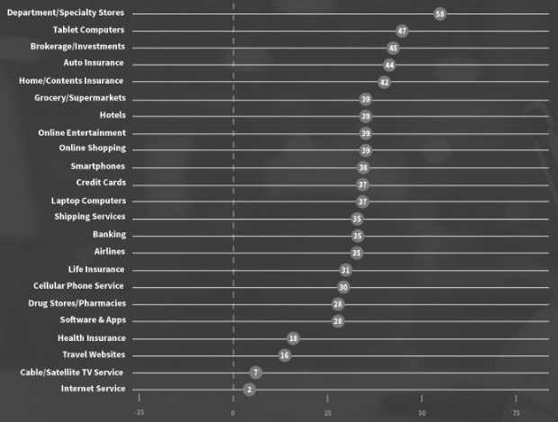
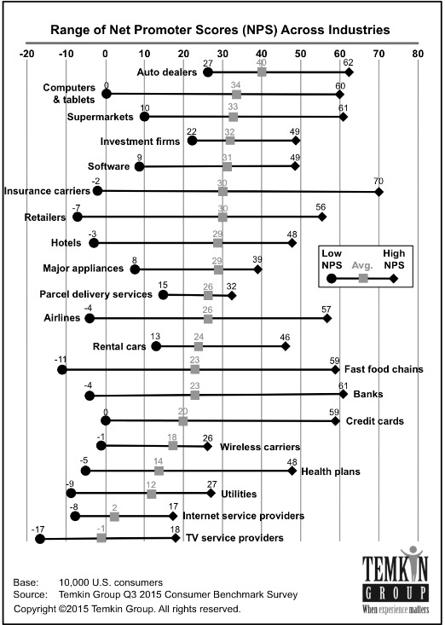
NPS – Benchmark Questionnaires
Benchmarks are available online to compare NPS scores
I’m not aware of NPS benchmarks for videogames
NPS from user research is highly dependent on the quality of the representativeness of sampling
Notes:
http://temkingroup.com/research-reports/net-promoter-score-benchmark-study-2015/
https://www.netpromoter.com/compare/

Slide 63
Self-determination theory – Post study Questionnaires
Player Experience of Need Satisfaction (PENS)
Rigby and Ryan at Immersyve (not a free tool)
Glued to Games … (a book they have published)
Based on self-determination theory
People do not buy and play games just because they are fun
Three universal and innate psychological needs that motivate people to initial behaviors, i.e., to do the things they do:
Competence
Relatedness
Autonomy
Motivations can be intrinsic or extrinsic
Notes:
https://www.amazon.ca/Glued-Games-Video-Draw-Spellbound/dp/0313362246
https://positivepsychologyprogram.com/self-determination-theory/
Competence: the desire to control and master the environment and outcome.
Reltedness: the desire to “interact with, be connected to, and experience caring for other people”
Autonomy: having a sense of free will when doing something or acting out of our own interests and values. Volition. Does not mean to be independent.

Slide 64
Data Analysis

Slide 65
Statistics Data analysis
Statistics: the best approach we have that’s better than guessing
Statistics is about risk management, not about ensuring 100% accuracy.
Typically, we use statistics to know that we will be right 95% of the time.
On the long run, we will only be wrong 1 out of 20 times.

Slide 66
Terminology Statistics
Population
All the people around the world who play the game
Sample
Small number of people sampled from the population who represent the game’s target audience
As user researchers, we rely on statistics to infer population’s behavior with games from a sample of participants

Slide 67
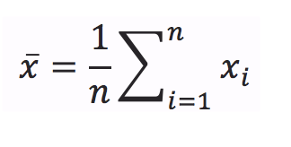
Fundamental measures – Central value Statistics
Mean or average
AVERAGE () in Excel
Calculation
Median or midpoint
MEDIAN() in excel
Calculation
Sort the data in increasing order
Take the observation in the middle
floor [(n + 1)/2]^{th} value
Data = [ 2, 1, 6 ]
Mean =
1/3 * (2 + 1 + 6)
9/3
3
Data = [ 2, 1, 6 ]
Median =
Sort the data: [1, 2, 6]
Floor [(3 + 1) / 2]^{th}
2th value
2

Slide 68
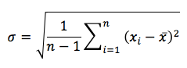
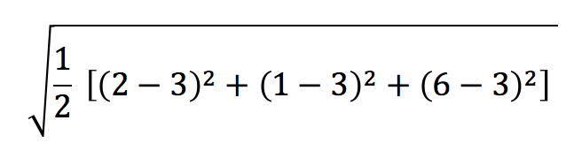
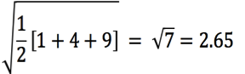
Fundamental measures – Spread Statistics
Back
Standard deviation (SD)
The amount of dispersion in the data
STDEV.S() in Excel
s
1 2 3 4 5 6
3
Data = [ 2, 1, 6 ] & mean = 3
Standard Deviation =
Notes:
Why n-1?
N-1 corrects for the fact that the sample variance tend to get smaller when a sample size is small.
To compute the geometric Standard Deviation, see: https://en.wikipedia.org/wiki/Geometric_standard_deviation

Slide 69
Fundamental measures – Spread median Statistics
MAD: Median Absolute Deviation
The amount of dispersion in the data
Data = [ 2, 1, 6 ] & median = 2
Median( [ |2-2|, |1-2|, |6-2| ] )
Median( [0, 1, 4] )
MAD = 1

Slide 70
Exercise: Fundamental measures Statistics
Calculate the mean, median, standard deviation and MAD
Use file: FundamentalMeasureData.xlsx
 | P1 | P2 | P3 | P4 | P5 | P6 | P8 | P8
Data | 99 | 69 | 51 | 32 | 89 | 121 | 36 | 150

Slide 71
Exercise solution: Fundamental measures Statistics
Calculate the mean, median, standard deviation and MAD
See file: FundamentalMeasureExercise.xlsx
Mean: 80.875
Median: 79
Standard deviation: 41.780
MAD: 35
 | P1 | P2 | P3 | P4 | P5 | P6 | P8 | P8
Data | 99 | 69 | 51 | 32 | 89 | 121 | 36 | 150

Slide 72
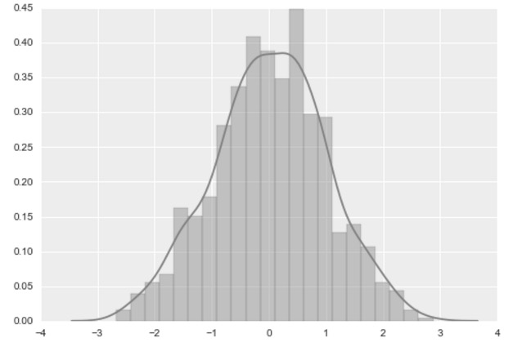
Distributions
Normal Distribution Statistics
Very frequently in natural and social sciences data tends to be around a central value with no skew left or right, like a bell curve
Such data is said to be normally distributed
Mean = median = mode
Several statistical methods we cover today have for assumption that the data is normally distributed
Histogram
Notes:
Mode: value that appears most often in a data set
Several type of distribution out there: Binomial, Poisson, chi-squared, multi-modal distributions, lognormal distribution

Slide 73

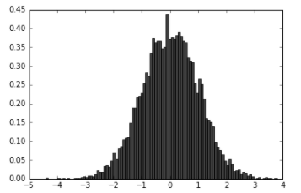
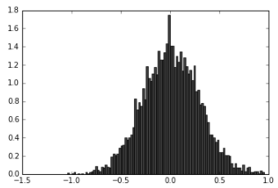
Central limit theorem: Estimating the population’s means from samples
Statistics
The normal distribution is ‘useful’ because of the central limit theorem
As the sample size goes to infinity, the distribution of the sample means will follow a normal distribution, no matter how the parent distribution looks like
When sampling from a normally distributed population, the normal population is preserved and the means are the same … also when sample size is small and sampling is large
Notes:
Further reading about CLT: https://www.methodsconsultants.com/tutorial/the-central-limit-theorem-and-its-implications-for-statistical-inference/
The distribution of means across repeated samples will be normal with a mean equal to the population mean. Here means on both sides are 0
and the sample’s standard deviation equals to the population standard deviation divided by the square root of n.
#Python code:
import numpy as np
import matplotlib.mlab as mlab
import matplotlib.pyplot as plt
%matplotlib inline
x = np.random.normal(0,1,10000)
n, bins, patches = plt.hist(x, 100, normed=1, facecolor='black', alpha=0.75)
plt.show()
x_ = np.array([])
smplsz = 12
for j in range(5000):
mysum = 0
for i in range(smplsz):
mysum = mysum + (x[np.random.random_integers(len(x)-1)])
x_ = np.append(x_, [mysum/smplsz])
n, bins, patches = plt.hist(x_, 100, normed=1, facecolor='black', alpha=0.75)
print("mean of uniform distribution = ", np.mean(x))
print("mean of sample means made of 12 samples", np.mean(x_))
plt.show()

Slide 74
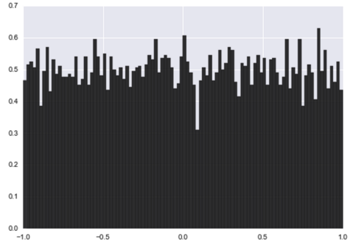
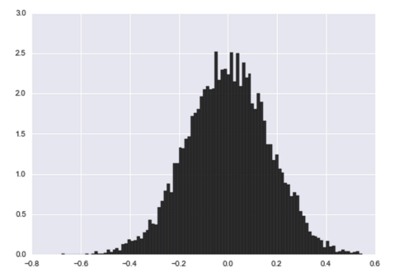
Central limit theorem: Example with uniform distribution
Statistics
The central limit theorem is also true when the population is not normal
The distribution of the data becomes normal at a small sample size. Here I used a sample size of 12 sampled 5k times

Slide 75
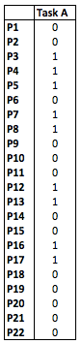
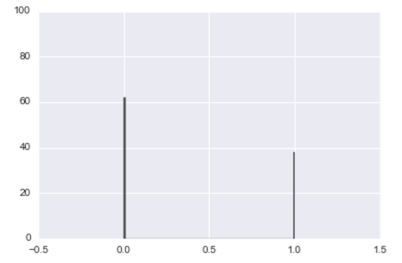
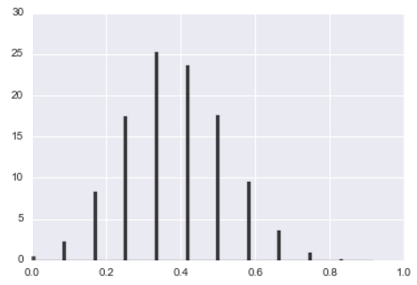
Central limit theorem: Example with bernoulli distribution
Statistics
The left graph shows task completion results of 100 participants
1 is the participant succeeded the task
0 if the participant failed the task
I took 5K sampling of size 12, to which I computed the means
I plotted a histogram of the 5k mean values on the right
The means of both distributions are the same
Mean = 0.39
Mean = 0.386
…
Notes:
#Python code:
import numpy as np
import matplotlib.mlab as mlab
import matplotlib.pyplot as plt
%matplotlib inline
def extractmeans(x):
x_ = np.array([])
smplsz = 12
for j in range(5000):
mysum = 0
for i in range(smplsz):
mysum = mysum + (x[np.random.random_integers(len(x)-1)])
x_ = np.append(x_, [mysum/smplsz])
return x_
x = np.array([])
for i in range(100):
if i <= 37:
x = np.append(x, 1)
else:
x = np.append(x,0)
np.random.shuffle(x)
n, bins, patches = plt.hist(x, 100, facecolor='black', rwidth=1, alpha=0.75 )
plt.ylim([0,100])
plt.xlim([-0.5,1.5])
plt.show()
x_ = extractmeans(x)
n, bins, patches = plt.hist(x_, 100, normed=1, facecolor='black', alpha=0.75)
plt.show
print("mean of mean of 12 samples x_=", np.mean(x_))
print("mean of uniform distribution x= ", np.mean(x))

Slide 76
Class example: Central limit theorem
Statistics
Below is data from some population
Each of us will randomly sample 12 numbers from that data, with replacement, and compute the mean, three times each. Then we will assemble our results together and see what happens
See file: CentralLimitTheoremExercise.xlsx for solution

Slide 77
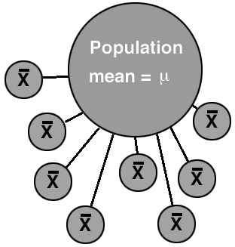
Estimation of the population’s mean
Statistics
If we can only take the mean (X) of one sample of 12 players, like we normally do when we conduct user research, how likely would we be to guess the population’s mean (μ) correctly?

Slide 78
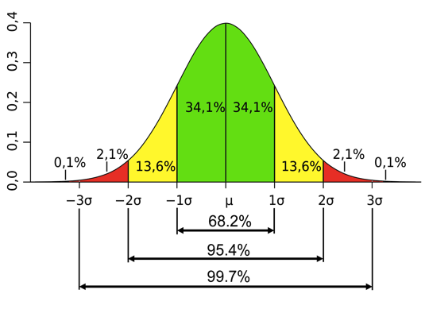
Normal distribution – σ units of standard deviation
Statistics
When we know that our data follows a normal distribution, and we know the mean and standard deviation, then we know when a value is unusual
1 σ: 68.2% of the values fall within the first standard deviation of the mean
2 σ: 95.4% within the second
3 σ: 99.7% within the third
The area under the curve add up to 100%
Example:
Suppose a sample mean is 7 with standard deviation 1
Then we know that 68.2% of the data ranges between 6 and 8
Notes:
SD frequently represented by the lowercase greek letter Sigma (looks like an ‘o’ in cursive)

Slide 79
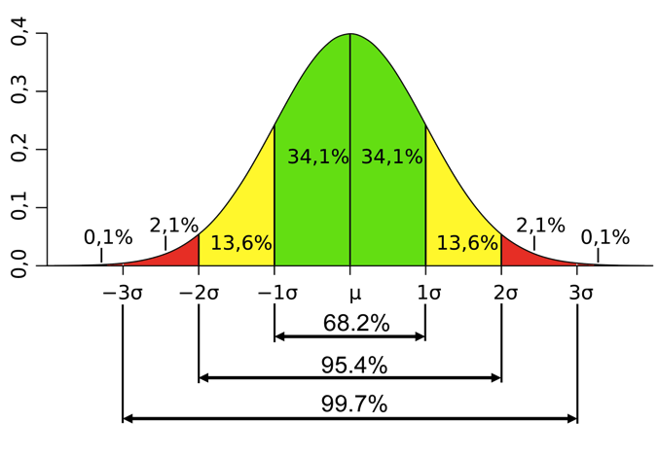
Estimation of the population’s mean with SD
Statistics
The mean = 0.38 and standard deviation σ = 0.14
68.2% of the data ranges between [0.38-(1*0.14), 0.38+(1*0.14)] = [0.24, 0.526]
95.4% of the data ranges between [0.38-(2*0.14), 0.38+(2*0.14)] = [0.106, 0.666]
99.7% of the data ranges between [0.38-(3*0.14), 0.38+(3*0.14)] = [-0.034, 0.806]

Slide 80
Certainty vs. mean’s error range
Statistics
Intervals around the means and levels of likelihood increase together, i.e., the more we are sure, the wider are the intervals; the less we are precise
At 62.8% likely, the range of [0.24, 0.526] = 0.526 - 0.24 = 0.286
At 95.4% likely, the range of [0.106, 0.666] = 0.666 - 0.106 = 0.56
At 99.7% likely, the range of [-0.034, 0.806] = 0.806 - (- 0.034) = 0.84

Slide 81


Estimation of the population’s mean with central limit theorem
Statistics
From the central limit theorem we know that sample means are normally distributed
So we can use the normal distribution to estimate our level of confidence when guessing a population’s mean using statistics from a sample mean, i.e., the Confidence Interval
X
Notes:
95.4% sure the population means is between -0.09 and 0.68
We have about 4.6% chances to be wrong

Slide 82
Confidence interval
Statistics
In practice, we don’t know the mean of the population, so we sample the population and try to guess it from a smaller group.
E.g., SUS scores
The chances that a sample point estimate of the mean differs from the population’s mean is highly likely, which is why we always present confidence intervals in our reports.
A confidence interval is an interval estimate of where could stand the population’s mean.

Slide 83
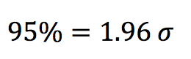

Level of certainty @ 95% with the z-distribution
Statistics
In research, a confidence interval of 95% is common: 1 chance out of 20 to be wrong
We know that 95.4% of the population is between -2 σ and 2 σ
95% of the population is between -1.96 σ and 1.96 σ
We cut the two tails off, which represent 2.5% on each side; two-tailed

Slide 84
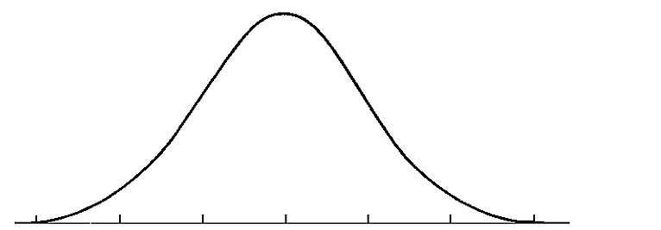
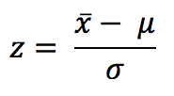
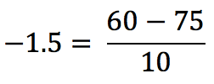
Z-score – The standard score Statistics
Number of standard deviations above and below the mean.
Say you have access to a game’s metrics from telemetry (population) and you know that the average score of all players is 75% with a standard deviation of 10%. You are asked, what are the chances a player scores below 60%
60
75
Then look -1.5 in a z-score table or simply use Excel:
NORM.DIST(60,75,10,TRUE) = 0.0668 = 6.68%
6.68% is the Cumulative Area Under the Curve from left to right (gray region)
There is less than 7% chances a player scores below 60
-1.5
0
z-score
Notes:
Explain mu and sigma
NORM.DIST(60,75,10,TRUE) returns the cummulative area from left to right.
NORM.DIST(60,75,10, FALSE) return the probability of getting exaclty 60 (about 1.3%).

Slide 85
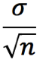
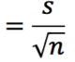
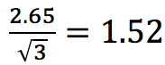
Standard Error – Sampling size matters
Statistics
The larger is the sample size, the higher the chances that its mean will be close to the parent’s population mean
If we sample the entire population, then the mean estimate of our population is the population’s mean
Just looking at the standard deviation is not enough
use symbol σ for standard deviation of the population
(use symbol s for standard deviation of the sample)
Standard Error
SE
Data = [ 2, 1, 6 ] s = 2.65
Standard Error =

Slide 86
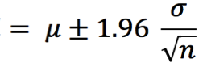
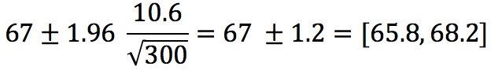
Level of certainty @ 95% with the z-distribution
Statistics
So, instead of providing a point estimate of the mean, e.g., 67%, we provide an interval, e.g., the mean = [65.8%, 68.2%]. We report the level of confidence of that interval, here 95%. The CI is 1.2% around the mean @ 95% of certainty
Confidence interval
CI
Mean = 67%, SDEV.P = 10.6, n = 300
Confidence interval =
What’s this?

Slide 87
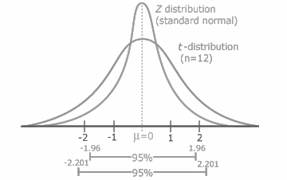
The t-distribution
Statistics
When sample size is less than 30, then we need to take into account additional errors
We use the z-distribution when the sample size equals or exceeds 30
We use the t-distribution when the sample size is less than 30; a flatter version
In practice, that means that our CI gets wider
Note: when n ≥ 30, then the shape of the t-distribution is similar to one of the z-distribution
Notes:
Developed by William Sealy Cosset – Guiness beer – published around 1904

Slide 88
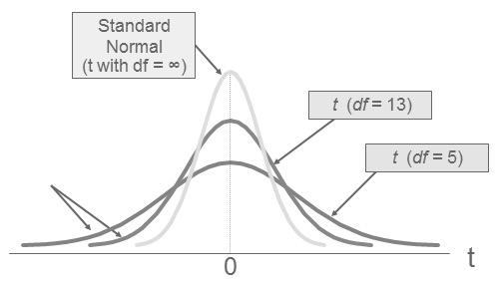
T-distribution – degrees of freedom
Statistics
The t-distribution is also know as Student distribution
The curve flattens as sample size gets smaller
Degrees of freedom (df) are the size of the sample minus one (n-1)
Say you have 10 participants, n=10. Then df = 10-1 = 9

Slide 89
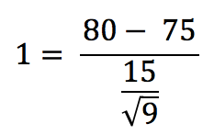
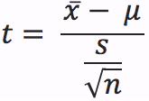
T-score— Converting data values into t-score Statistics
Say you know that the average score of all players who tested the game so far is 75. You invited 9 new participants to test the game and want to know what is the probability they get a score higher than 80 given a standard deviation of 15?
Sample mean
Expected value
Then use Excel to find the probability:
TDIST(t-score, degrees of freedom, tail) = TDIST(1,8,1) = 0.1733
With TDIST, the cumulative area under the curve is on the right
There is 17 % changes a player scores higher than 80.
0
1
t-score

Slide 90
Exercise: Probability with t-distribution
Statistics
Say you know that the average score of all players is 75. You invited 9 participants to test the game and want to know what is the probability they get a score between 75 and 80 given a standard deviation of 15?

Slide 91
Exercise solution: Probability with t-distribution
Statistics
Say you know that the average score of all players is 75. You invited 9 participants to test the game and want to know what is the probability they get a score between 75 and 80 given a standard deviation of 15?
What’s the probability of getting higher than 80 again?
0.1733
Then we calculate the probability of getting lower than 80
1 - 0.1733 = 0.8267
What the probability of getting 75?
t = (75-75) / (15/√(9)) = 0
t ( 0 ) = 0.5 (right at the center of the Gaussian curve!)
Thus, 0.8267 – 0.5 = 0.3267 = 33% chances of getting between 75 and 80
1 chance out of 3!

Slide 92
T-test vs. z-test
Statistics
Do we know the population’s standard deviation?
Yes:
Is the sample size above 30?
Yes:
Use the z-score
No:
use the t-score, but replace s in the t-score formula with σ
No:
Use the t-score
If we have a larger sample (over 30), the t-distribution and z-distribution look pretty much the same.
If we know σ, we substitute σ into the equation in place of s
T = (X – μ) / [ σ/√(n) ]
This makes the equation identical to the one for the z-score; the only difference is we are looking up the result in the T table, not the Z-table. For sample sizes over 30, you’ll get the same result.

Slide 93
P-value: Definition
Statistics
P-value: is the area under the curve.
-1.5
0
z-score
P-value is the AUC
0
1
t-score

Slide 94
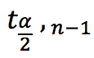
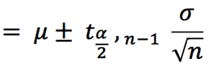
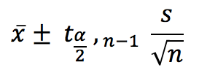
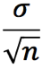
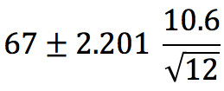
CI with the t-distribution at a level of certainty of 95%
Statistics
When we don’t know the standard deviation of the population
The calculation is very similar to CI with z-distribution, but the ‘number’ of standard deviation increases because the t-distribution is more spread out.
The t-distribution takes degrees of freedom into account to adjust the spread.
in Excel is TINV(1 - 0.95, n - 1)
Confidence interval (CI)
CI
Mean = 67%, SD = 10.6, n = 12, TINV(0.05, 11)
Confidence interval =
s

Slide 95
Exercise: Confidence interval of small sample size
Statistics
You received the following satisfaction score from a group of 12 participants:
[7, 8, 3, 9, 9, 6, 8, 5, 10, 4, 6, 10]
Calculate the confidence interval of the mean at a certainty level of 95%
Excel functions you will need:
AVERAGE()
STDEV()
COUNT()
TINV(1-0.95, n-1)

Slide 96
Exercise solution: Confidence interval of small sample size
Statistics
AVERAGE(7, 8, 3, 9, 9, 6, 8, 5, 10, 4, 6, 10) = 7.08
STDEV(7, 8, 3, 9, 9, 6, 8, 5, 10, 4, 6, 10) = 2.31
COUNT(7, 8, 3, 9, 9, 6, 8, 5, 10, 4, 6, 10) = 12
TINV(1-0.95, 12-1) = 2.2
[7.08 - (2.2 * 2.31 / SQRT(12)), 7.08 + (2.2 * 2.31 / SQRT(12))]
Confidence interval of the mean at a 95% level of certainty = [5.61, 8.55]
What does this interval represent again?

Slide 97
Confidence interval – Interpretation @ 95%
Statistics
The confidence interval of the mean @ 95% is [5.61, 8.55].
In English this means that:
Assuming that our sample of participants represents well the population of which we want to make statements, then:
We are 95% sure that the population’s mean is not lower than 5.6/10 and not higher than 8.6/10
It’s very unlikely that the game will receive a score higher than 8.6/10 by all players when released on the market
What happens to the CI when you increase the level of confidence to 99%?
Verify!

Slide 98
Exercise solution: Confidence interval of small sample size @ 99%
Statistics
With 99% level of certainty…
AVERAGE(7, 8, 3, 9, 9, 6, 8, 5, 10, 4, 6, 10) = 7.08
STDEV(7, 8, 3, 9, 9, 6, 8, 5, 10, 4, 6, 10) = 2.31
COUNT(7, 8, 3, 9, 9, 6, 8, 5, 10, 4, 6, 10) = 12
TINV(1-0.99, 12-1) = 2.2 3.11
[7.08 - (3.11 * 2.31 / SQRT(12)), 7.08 + (3.11* 2.31 / SQRT(12))]
Confidence interval of the mean at a level of certainty of 99% = [5.0, 9.2]
Response: the interval with increases compared to CI @ 95% = [5.6, 8.6]
Revisit CI at the bottom of file: CentralLimitTheoremExercise.xlsx

Slide 99
Exercise: Confidence interval of SUS
Statistics
You received the following SUS ratings from a group of 5 participants. Calculate the upper and lower bound of the confidence interval at a level of certainty of 95% of the SUS score
Use file: SUS_calculationsExercise_data.xlsx
 | P1 | P2 | P3 | P4 | P5
1. I think that I would like to use the game frequently. | 2 | 4 | 3 | 3 | 3
2. I found the game unnecessarily complex. | 0 | 4 | 1 | 0 | 1
3. I thought the game was easy to use. | 2 | 4 | 3 | 3 | 3
4. I think that I would need the support of a technical person to be able to use the game. | 0 | 1 | 0 | 0 | 1
5. I found the various functions in the game were well integrated. | 4 | 4 | 3 | 3 | 3
6. I thought there was too much inconsistency in the game. | 0 | 1 | 0 | 0 | 1
7. I would imagine that most people would learn to use the game very quickly. | 1 | 4 | 3 | 3 | 3
8. I found the game very cumbersome to use. | 2 | 1 | 0 | 0 | 1
9. I felt very confident using the game. | 3 | 4 | 3 | 3 | 3
10. I needed to learn a lot of things before I could get going with the game | 4 | 1 | 0 | 0 | 1
sc * 2.5
(4-sc) *2.5
sc * 2.5
(4-sc) *2.5
sc * 2.5
(4-sc) *2.5
sc * 2.5
(4-sc) *2.5
sc * 2.5
(4-sc) *2.5

Slide 100
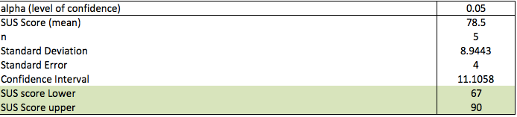
Exercise solution: Confidence interval of SUS
Statistics
The game is considered more usable than at least 47% and at most 99.8% of systems tested in a database of 446 studies (over 5000 responses)
See file: SUS_calculationsExercise.xlsx

Slide 101
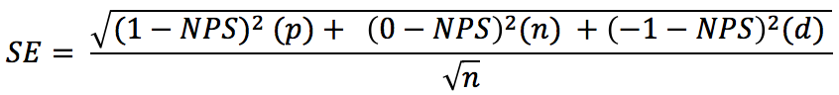
NPS – Confidence interval Statistics
Here’s how we can compute the confidence interval of NPS score
n = sample size
p = % promoters
n = % passives
d = % detractors
t = TINV(0.05, n-1)
CI = NPS ± t * SE

Slide 102
Exercise NPS
Statistics
You administered NPS questionnaires on two games. Here’s what you received:
GAME A
18 p
8 n
7 d
GAME B
10 p
12 n
6 d
Compute and plot the NPS CI of both game at 95% of certainty?

Slide 103
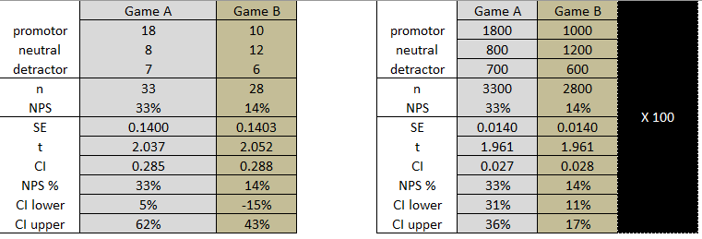

Exercise NPS
Statistics
You administered NPS questionnaires on two games. Here’s what you received:
See file: NPS CI.xlms

Slide 104
Recapitulation
Statistics
Thanks to the central limit theorem, we know we can guess the population’s mean by measuring the mean of a sample.
We know that point value estimates should not be used because the risks of guessing wrong are too high: confidence intervals should be used instead
we rely on the t-distribution when sample size is less than 30 and/or we don’t know the standard deviation of the population

Slide 105
Hypothesis testing
Statistics
We are now interested in comparing A/B scores against one another.
Are they different?
Inferential statistics is based on the premise that we cannot prove something to be true, but we can disprove something by finding an contradiction
H_{o}: all videogames require skills
H_{a}: not all videogames require skills
When we can disprove H_{o}, then we say we reject it and accept H_{a}
The hypothesis is always about the population parameters, not the sample value or statistics

Slide 106
Hypothesis testing –Examples
Statistics
H_{a} is normally the thing we are trying to find out about
H_{o} is normally the opposite of status quo
H_{o}: Players experience the same level of satisfaction when playing character X and Y
H₁:
H_{o}: The controls for characters X and Y are equally effective (usability)
H₁:
H_{o}:
H_{a}: Enemy X is easier to eliminate than Enemy Y

Slide 107
A/B testing with t-tests
Statistics
T-tests are used to compare means scores and determine if they are significantly different from each other. That is, if the difference observed is by chance or not
A/B testing: we use a t-test when we have two sets of responses and we want to determine if the sets are significantly different from each other. If they are, then we use the mean values to determine which one is best
E.g., SUS questionnaire scores

Slide 108
T-tests – Assumptions
Statistics
T-test
Independence of observations
The two populations being compared follow a normal distribution
Homoscedasticity — The variance in both groups are approximately equal
In practice, t-tests can sometimes be resilient to the two last assumtions
Notes:
Independence: – e.g. A doesn’t depend on B

Slide 109
T-tests – Excel Parameters
Statistics
Within subjects
Same participants A/B test a game
Between subjects
Different participants A/B test a game. Some test A others test B
1-tail vs. 2-tails
Initial assumption
Homoscedasticity of variance
The variance in both groups

Slide 110
T-test, within vs. between subjects
Statistics
Paired (within subjects)
EXCEL 2 tailed t-test: TTEST( {2,6,1} , {1,5,4} , 2, 1 )
Unpaired (between subjects) – Homoscedasticity of variance
EXCEL 2 tailed t-test: TTEST( {2,6,1} , {1,5,4} , 2, 2 )
Unpaired (between subjects) – Heteroscedasticity of variance
EXCEL 2 tailed t-test: TTEST( {2,6,1} , {1,5,4} , 2, 3 )
2 = two tails
Not possible to change confidence level in TTEST. Set at 95% by default

Slide 111



T-test, 1-tail vs. 2-tails
Statistics
Always in the direction of your alternative hypothesis: sample mean is smaller
EXCEL 1 tailed t-test: TTEST( {2,6,1} , {1,5,4} , 1, 2)
5 % of area
- 1.645 𝜎
5% of area
- 1.96 𝜎
+ 1.96 𝜎
5% of area
+ 1.645 𝜎

Slide 112
T-test, 1-tail vs. 2-tails
Statistics
Always in the direction of your alternative hypothesis: sample mean is bigger
EXCEL 1 tailed t-test: TTEST( {2,6,1} , {1,5,4} , 1, 2)
5 % of area
- 1.645 𝜎
5% of area
- 1.96 𝜎
+ 1.96 𝜎
5% of area
+ 1.645 𝜎

Slide 113
T-test, 1-tail vs. 2-tails
Statistics
Always in the direction of your alternative hypothesis: means are different
EXCEL 2 tailed t-test: TTEST( {2,6,1} , {1,5,4} , 2, 2)
5 % of area
- 1.645 𝜎
5% of area
- 1.96 𝜎
+ 1.96 𝜎
5% of area
+ 1.645 𝜎

Slide 114
Hypothesis testing
Statistics
The hypothesis that H₀ is true vs. H_{a} the alternative hypothesis
5 % of area
- 1.645 𝜎
5% of area
- 1.96 𝜎
+ 1.96 𝜎
5% of area
+ 1.645 𝜎
One-Tailed
H₀: A ≥ B
H_{a}: A < B
Two-Tailed
H₀: A = B
H_{a}: A ≠ B
One-Tailed
H₀: A ≤ B
H_{a}: A > B

Slide 115
One-tailed vs. two-tailed
Statistics
Two-tailed:
You have no hypothesis about which one beats the other.
One-tailed:
Your alternative (or research) hypothesis is that B beats A, or the inverse.
Most frequent question
H₀ : the currently accepted value for a parameter
H_{a}: the research hypothesis. Claim to be tested
Two-Tailed
H₀: A = B
H_{a}: A ≠ B
One-Tailed
H₀: A ≤ B
H_{a}: A > B
One-Tailed
H₀: A ≥ B
H_{a}: A < B
Two possible outcomes:
Reject H₀
Fail to Reject H₀
Notes:
Learn more about null and alternative hypothesis testing: https://www.youtube.com/watch?v=VK-rnA3-41c

Slide 116
Statistical power definition
Statistics
Statistical power is the probability that the test correctly rejects the null hypothesis H_{o} when a specific alternative hypothesis H_{a} is true
Type II error is when a study concludes that there is NO effect when in fact there is one
We fail to reject H_{o} when we should
One can compute the statistical power of a test to determine if the sample size is large enough, or, how many participants would be required to detect an effect.

Slide 117






Statistical power with t-tests – within vs. between subjects
Statistics
Between subjects
p = 0.6 ➔ fail to reject H_{o}
Note: a bigger divisor makes the t score smaller. All things being equal, the bigger the t score, the more likely we are to reject H₀. Recall that the t score is the number of standard deviations from the mean. -3.04 is much further away from the mean than -0.55
Within subjects
p = 0.02 ➔ reject H_{o}
See file: tTestBetweenVsWithin.xlsx

Slide 118

Exercise: t-test on SUS scores
Statistics
You designed a within-subject experiment on 12 participants. You tested two versions of the menus in a game. Each participant tested both versions and filled out a SUS questionnaire per version. You want to compare the SUS scores to determine which version is easier to use and learn, @ 95% certainty
Use file: ttestSUSExercise_data.xlsx

Slide 119

Exercise solution: t-test on SUS scores
Statistics
Menu A is better
See file: ttestSUSExercise.xlsx

Slide 120

A/B/n testing – α inflation problem with repetitive t-tests
Statistics
Comparing A, B, C, D,…: The chances of rejecting H₀ (saying that the means are different) ‘adds up’ every time we run a t-test. This phenomenon is known as alpha inflation
Analogy: computing a t-test is like rolling a dice:
E.g., what are the chances of getting a 5 at least once if we roll the dice once, twice, …?
The chances of rejecting H₀ can be expressed by the equation: 1-(1-α)^{m}
Error grows with number of t-test comparisons (m is the number of repeated t-tests)
When we reject Ho and we should not, we call this an Error of Type 1
See file: alphaInflation.xlsx
Notes:
Alpha inflation: http://webstat.une.edu.au/unit_materials/c7_anova/oneway_problem_alpha.htm
Familitywise error rate: https://en.wikipedia.org/wiki/Family-wise_error_rate

Slide 121
Family-wise error rate: More on α inflation
Statistics
Comparing A, B, C, D,…: t-tests are inadequate because error adds up at every t-test comparison, making the risk of getting false positive error is too high (rejecting H₀ when we should not). Here’s an example:
With α = 0.05 and 1 comparison, the probability of rejecting Ho is
1-(1-α) = 1-(1-.05)¹ = 0.05
With 3 comparisons the probability of rejecting Ho is
1 – (1 – α)³ = 1 – (1 – .05)³ = 0.142525
This means that the probability of rejecting the null hypothesis is 14.3%, not 5%. We are much more likely to reject Ho than we think!
Notes:
Hype tps://en.wikipedia.org/wiki/Bonferroni_correction

Slide 122
Family-wise error rate: α correction
Statistics
When t-test is used to compare three or more sets of responses we need to apply a correction to α.
Bonfferoni
Holm-Bonfferoni
Here’s several post-hoc tests
See: SUSdataANOVA.xlsx
Notes:
http://www.statisticshowto.com/post-hoc/

Slide 123

FWE: Bonfferoni correction
Statistics
Divide the alpha level by the number of tests you’re running and apply that alpha level to each individual test.
Tests: A, B, C, D, E = 5 paired-wise tests
Target α = 0.05
Corrected α = 0.05/5 = 0.01
Then the p-value would have to be .01 or less for statistical significance at 0.05
P_{AB} = 0.05
P_{AC} = 0.04
P_{AD} = 0.01
P_{AE} = 0.03
P_{BC} = 0.1
Although the Bonferroni correction is simple to calculate, it suffers from a lack of statistical power. The Holm-Bonferroni method (next slide) is more powerful than the single-step Bonferroni, but more work to compute.
Notes:
http://www.statisticshowto.com/post-hoc/

Slide 124


FWE: Holm-Bonfferoni method
Statistics
Target α = 0.05
Sort t-tests’ p-values from smallest to largest
Compute HB iteratively
The testing stops when you reach the first non-rejected hypothesis
All subsequent hypotheses are non-significant (i.e. not rejected).
Test | Rank order | P-Value | HB | HB ≤ P-value?
BC | 1 | 0.005 | 0.005 / (4-1+1) = 0.0125 | 0.005 ≤ 0.0125
BD | 2 | 0.01 | 0.01 / (4-2+1) = 0.0167 | 0.01 ≤ 0.0167
BE | 3 | 0.03 | 0.03 / (4-3+1) = 0.025 | 0.03 ≥ 0.025
CD | 4 | 0.04 | 0.04 / (4-4+1) = 0.04 | Don’t do
Notes:
http://www.statisticshowto.com/holm-bonferroni-method/

Slide 125
A/B/n testing – ANOVA
Statistics
Analysis of variance (ANOVA) can be used to determine if more than two means are significantly different from each other
A/B/n testing: we use an ANOVA when we have three or more sets of responses and we want to determine if the sets are different from one another. If they are different, then we use post-hoc tests to determine which one is best
That is, ANOVA test tells us whether we have an overall difference between our groups, but it does not tell us which specific groups differed – post hoc tests do

Slide 126
ANOVA – Assumptions
Statistics
ANOVA
Independence of observations – e.g., A doesn’t depend on B
Homoscedasticity — The variance in groups are approximately equal
Normal distribution of the residual
Notes:
Independence: – e.g. A doesn’t depend on B

Slide 127
ANOVA – Intuition behind ANOVA
Statistics
Anova uses the ratio of the variation between groups and the variation within groups to determine if the means of the groups are statistically different
When the sum of variation between groups is larger than the sum of variation within groups, then the F-statistic value gets larger. A large ratio tells us that the variation in the data is due mostly because of the actual variation between groups, not within
If the F-Statistic is greater than the critical F-statistic (α = 0.05), which we find in tables or in Excel, then we conclude that there probably is a difference between the groups.
The variation between groups (SS_{B})
The variation within groups (SS_{W})
F-statistic =
Notes:
The F-statistic is the ratio of two Chi-square distributions
https://youtu.be/-yQb_ZJnFXw
https://www.youtube.com/watch?v=EFdlFoHI_0I
https://www.youtube.com/watch?v=j9ZPMlVHJVs&t=213s
https://www.youtube.com/watch?v=Xg8_iSkJpAE&t=354s

Slide 128
ANOVA – Available tools
Statistics
On PC, we can use the Analysis ToolPack to perform ANOVA in Excel or R or Python
MAC: see file SUSdataANOVA.xlsx
On MAC (PC and Linux), use R to compute ANOVA (or Python with Scipy and Pandas)
Notes:
Python link: http://www.randalolson.com/2012/08/06/statistical-analysis-made-easy-in-python/

Slide 129

One factor ANOVA with Excel, page 1/2
Statistics
We receive 4 scores for a game (A/B/n testing): Are they different?
We plot the means and confidence intervals
Perform an ANOVA on the data: 4 levels, one dependent variable
Check if the p-value ≤ 0.05 (if so, we know that at least two versions are different)
If p-value ≤ 0.05, then we run t-tests pairwise comparisons on levels, with correction on α, in order to identify which one surpasses the other

Slide 130


One factor ANOVA with Excel, page 2/2
Statistics
ANOVA results:
See files: InstructionANOVAEXCEL.docx, rawSUSdata4ANOVA.csv and SUSdataANOVA.xlsx
Bonferroni correction:
α / number of levels
reject H₀ if p-value ≤ 0.0125 (i.e., 0.05/4)

Slide 131
Parametric tests: Assumptions
Statistics
We have seen that both t-tests and ANOVA make assumptions about the data
Thus, we need to verify that assumptions are met, and if not, we need to get a measure of how severe things are

Slide 132


Test assumptions of normality
Statistics
Skewness (SKEW in Excel)
Mean = Median = Mode
Histogram
Excess Kurtosis (KURT in Excel)
Platykurtic: Excess Kurosis < 0
Leptokurtic: Excess Kurosis > 0
Notes:
https://en.wikipedia.org/wiki/Normality_test

Slide 133
Test assumptions of normality: Chi-square goodness fit test
Statistics
Several methods exists to check if data is normally distributed or not
Chi-square is easy and reliable when n > 50. Here are the steps:
Break down the data by value and frequency
Compute the mean and standard deviation of the observed data
Compute the expected frequency at every given bin using mean, stdev, n and NormDist in Excel
Compute the Chi-square goodness fit score of observed data and Chi-square critical
Compare Chi-square goodness fit against expected Chi-square values
If Chi-square goodness fit score > expected Chi-square critical value, then reject H_{o}: data is not normally distributed
Otherwise retain H_{o}: no evidence in the data suggests it is not normally distributed (thus assume it is normally distributed)
See file: Normality.xlsx
Notes:
https://en.wikipedia.org/wiki/Normality_test

Slide 134


Test assumptions of normality: Shapiro-Wilks
Statistics
Shapiro-Wilks when n ≤ 50 to test if data is normally distributed or not
We sort the data in increasing order
We find the coefficients a_{i} for the Shapiro-Wilk test– based on sample size
We compute b
We compute the Sum of Squares (SS)
We compute the statistic W = b²/ SS
We use the table of quantiles of the Shapiro-Wilk test for normality to determine the p-value for the test.
If the p-value > 0.05, retain H_{o}: (thus, conclude the data is normally distributed)
See file: Shapiro-Wilks.xlsx
Notes:
https://en.wikipedia.org/wiki/Normality_test

Slide 135

Test assumptions of normality: QQ-Plots
Statistics
We sort the data in increasing order
We compute the percentile of the data’s midpoints
For all points: (x_{i} – 0.5) / n
We find the z-theoretical score for every percentile (probabilities)
Excel: NORM.S.INV(x_{i})
We find z-observed score for every x in X
Excel: x_{i} – x / stdev(X)
We plot the z-theoretical data over z-observed data
We plot trendline and its equation
All points should be along the line. The m slope should roughly = 1, here m = 0.9903
See file: QQ-plot.xlms
Notes:
https://en.wikipedia.org/wiki/Normality_test

Slide 136
Test assumptions of homoscedasticity: F-test
Statistics
Two data sets
We compute the variances of each set
We compute F-critical value: Use Excel FINV(0.05, df1, df2)
We compute F-observed: Divide the larger value by the smallest
H_{o}: the variability is the same between the two data sets
If F-observed >= F-critical, then we reject H_{o}
Otherwise, we retain H_{o} and conclude that the variance is not different
See file: Homoscedasticity.xlms

Slide 137
Test assumptions of homoscedasticity: Levene’s test
Statistics
Three or more data sets
We compute the means of each data set
We compute the absolute residual
We perform an Anova Single factor on residual (which must satisfy the assumptions of Anova)
H_{o}: the variability is the same between all data sets
If the p-value <= 0.05, we reject H_{o}
Otherwise, we retain H_{o} and conclude that the variance is not different
See file: Homoscedasticity.xlms

Slide 138
When assumptions not met
Statistics
When assumptions are not met, we can turn to different methods to compare multiple test scores (A/B/n)

Slide 139

Kruskull Wallis
Statistics
The Kruskal Wallis test is an alternative to one-factor ANOVA between subject
Ranks of the data are used rather than the actual data points
The test determines whether the medians of two or more groups are different
We calculate a test statistic called H and compare it to a distribution cut-off point
The hypotheses for the test are:
H_{o}: medians are equal
H_{a}: medians are not equal
Use Friedman for within subject
Notes:
https://en.wikipedia.org/wiki/Friedman_test

Slide 140
Kruskull Wallis: Example
Statistics
You received satisfaction scores of 12 players (within subject). Three treatments were tested:
New: Character wore an improved armor
Old: Character wore the original armor
Control: Character did not wear an armor
Is there a difference between the scores?

Slide 141


Kruskull Wallis: Example solution
Statistics
We rank the raw score
We compute H on the ranked data
n is total number of observations
Rj is the sum of the ranks of group j
nj is the size of the jth group
k is the total number of groups (3 here)
See file: Kruskal.xlms

Slide 142
Wilcoxon signed-rank test
Statistics
An alternative to the t-test when the assumption of normality is not met
Good for within-subject design
Steps:
We compute the absolute difference between the pairs, but preserve the signs (- or +)
We rank these values by size
We allocate the signs we preserved to every rank value (make negative if applicable)
We sum all positive rank values together and sum all negative rank values together
Out of these two values, we choose the smallest absolute one and compare it with critical values from the wilcoxon_signed_rank_table.pdf
We use the Bonfferoni adjustment if we are comparing several pairs
See file: Wilcoxon.xmls

Slide 143



Mann-Whitney U test when n ≤ 20
Statistics
An alternative to the t-test when the assumption of normality is not met
Good for between-subject design
Steps:
Rank the data together
Sum the ranks of groups
Count number of items in each group (e.g., n₁, n₂)
Compute U_{i} for each group, preserve the smallest one only
Compare it with U-Critical (found in Mann-Whitney U table.pdf)
Use the Bonfferoni adjustment when comparing several pairs
See file: Mann-Whitney_U.xmls

Slide 144



Mann-Whitney U test when n > 20
Statistics
When n > 20 we need to approximate the U-critical from the normal population. We compute μ, σ² as follows and then use these parameters to compute a z-score
Where n₁ and n₂ are the number of items in each group
We compute z with a continuity correction factor of 0.5
U-Critical
If U is less than U-critical, reject H_{o}: results are different
See file: Mann-Whitney_U.xmls

Slide 145

Distributions
Lognormal distribution Statistics
Task-time-duration data is not normally distributed
Because it’s positively skewed
the mean is not a good measure of the center of the distribution
E.g., questionnaire score
E.g., duration time

Slide 146


Lognormal – Central value for time duration Statistics
The right graph is a logarithm of the data from the left graph
Note how the logarithm of the distribution loses it skewness a becomes normal
Then we can find the central value using the standard mean operation on the resulting distribution
Last, we compute inverse operation (exponent) on the value to retrieve the actual mean
This process is known as computing the geometric mean
ln(x)
Notes:
#Log(1,n) = 0
# Python code
import numpy as np
from scipy.stats import t as student_t
from matplotlib import pyplot as plt
import math as mth
%matplotlib inline
mu, sigma = 0, 1.5
x = mu + sigma*np.random.randn(10000)
x_ = np.exp(x)
#print(x_)
# the histogram of the data
#n, bins, patches = plt.hist(x_, 1000, alpha=0.75, facecolor='black')
#plt.axis([0, 20, 0, 1600])
x = np.log(x_)
n, bins, patches = plt.hist(x, 50, alpha=0.75, facecolor='black')

Slide 147


Fundamental measures – Central value for time duration Statistics
Geometric mean
GEOMEAN () in Excel
Data = [ 2, 1, 6 ]
Geomean =
Optimal approach for time when data size is 25 or less, otherwise use the median

Slide 148
Task time – Geomean with natural logarithm
Statistics
We have learned how to compute the central value of time when the number of data points is less than 26
Excel: GEOMEAN()
Another way to compute the geomean consists in taking the logarithm of every time value, compute the arithmetic mean on these values and then convert back the log mean into its original unit using the exponent operation
Data = [ 2, 1, 6 ]
GEOMEAN(2, 1 6) = 2.29
EXP(AVERAGE(LN(2), LN(1), LN(6))) = 2.29

Slide 149
Fundamental measures – Spread Geo Standard Deviation
Statistics
Geometric Standard Deviation
Similar to geomean method
Data = [ 2, 1, 6 ]
GEO STDEV (2, 1 6) = 2.29
EXP(STDEV(LN(2), LN(1), LN(6))) = 2.46
Notice how they differ

Slide 150


Task time – Confidence interval on the mean
Statistics
We need to use the same approach to compute the standard deviation on these values The rest is the same
x_{log}: mean in logarithm unit
s_{log}: standard deviation in logarithm unit
n: number of participants
Data = [2,1,6]
x_{log} = AVERAGE(LN(2), LN(1), LN(6)) = 0.83
s_{log} = STDEV(LN(2), LN(1), LN(6)) = 0.9
t_{0.05,2} = TINV(0.05, 3-1) = 4.3
Confidence interval on the mean =
Note: X_{log} should be X_{ln} (same thing for of S_{log})

Slide 151

Task time – Confidence interval on the median - Example
Statistics
When the amount of data points is more than 25, the median is recommended to estimate the central value. A confidence interval should also be computed
n is the number of data points
p is 0.5 for the median
z_{(1-𝛼/2)} is the number of standard deviation
EXCEL @ 95%: NORMSINV(1-0.05/2)
Note: the two values we receive are the indices of the upper and lower bound of the CI

Slide 152
Exercise: Task time – Confidence interval on the median
Statistics
Compute the median and confidence intervals of this time data produced by 30 participants:
155 33 120 157 99 143 90 91 143 163 183 189 175 158 112 180 84 183 114 133 138 110 191 88 174 162 159 76 84 96
The data is already entered in: TaskTimeExercise_data.xlsx

Slide 153


Exercise solution: Task time – Confidence interval on the median
Statistics
See solution file: TaskTimeExercise.xlsm

Slide 154
Lab exercises
Statistics
}
Study A: 11 Participants
SMEQ
SAT
Study A
Week 11
11 Participants
Study B
Week 12
12 Participants
Study C
Week 13
14 Participants
SMEQ
SAT
X 3
SMEQ
SAT
SMEQ
SAT
SMEQ
SAT
NPS
SUS

Slide 155
Lab exercises
Statistics
You tested the onboarding of a game iteratively 3 times on three groups of participants
The results can be found in lastExercise.xlms file
Questions: any evidence that things are progressing?

Slide 156

Success rate - Example
Statistics
Suppose that 70 out of 100 participants completed a task of successfully beating the boss. What is the worst case scenario when the game is released (assuming the participants invited are a good representation of the population)?

Slide 157
Appendix
Success rate produces dichotomous data, e.g., participants succeed a task or not, convert or not, get a 10 XP reward or not
Success rate is a fundamental metric in user research
Thus we will examine the Wald and Wilson interval methods to measure confidence intervals of success proportions
As you now know, reporting findings as point estimate is unscientific. The chance that the sample point estimate is the same as the unknown population completion rate is very unlikely. We always present confidence intervals
Later, we will examine the McNemar, Fisher and N-1 Chi Square methods to determine when success rates from different treatment levels are statistically different from one another (A/B testing)

Slide 158
Success rate - Example
Appendix
Suppose that 70 out of 100 participants completed a task of successfully beating the boss. What is the worst case scenario when the game is released (assuming the participants invited are a good represntation of the population)?

Slide 159





Success rate – Wald confidence intervals method
Appendix
The Wald interval method was developed by Laplace about 200 years ago and is still used today.
Now known as the Wald interval method after the 20th century statistician Abraham Wald
Works when n ≥ 100
is the success rate proportion
in Excel NORMINV(0.975,0,1)
Wald Intervals
WI =
Success rate proportion = 70%, n = 100
Wald Intervals =
@ 95% level of certainty

Slide 160



Success rate – Wilson confindence intervals method
Appendix
The adjusted-Wald Interval works with groups of all sizes. It’s known as the Wilson method. Like the Wald method, but a preparation step is needed
x: number of successes
n: number of participants
z: z-score is the number of SD at a given level of certainty
Preparation step:
Calculate the Wilson interval =

Slide 161



Success rate – Wilson intervals method – Example
Appendix
Suppose that 7 out of 10 participants completed a task of successfully using a combo after trying for 30 seconds or less. What’s the confidence interval of the success rate (@ 95% level of certainty)?
x = 7
n = 10
z = 1.96

Slide 162
Success rate – Interpretation
Appendix
Any value within the interval of [39%, 90%] is plausible, those outside would be implausible
So, we are 95% confident that the mean completion rate of the population ranges between 39% and 90%
Since we received one success score per participant, we can say:
Assuming that our participants represent well the population of players, it is plausible that 6 out of 10 players will be unable to use a combo within the first 30 seconds

Slide 163

Exercise: Success rate
Appendix
You have tested a new way to move letter tiles on a crossword game on Apple TV. You observed that 8 out of 10 participants could successfully figure out how to move tiles in less than 30 seconds, without being administered a tutorial. Now, the producer is convinced that more than 75% of all players will ‘get it’ without a tutorial and decides to drop the tutorial
Can you find any evidence at 95% changes to be right that the producer might need to serve a tutorial?
What can you do to bring your results closer to your producer’s expectation (75% success rate)?
Hint: NORMINV(1-(0.05/2), 0, 1)

Slide 164
Exercise Solution: Success rate
Appendix
Can you find any evidence at a level of confidence of 95% that he should make the tutorial?
See file CompletionRateClassWilsonExercise.xlsx
Wilson interval method returns an interval of [48%, 95%], which means that 52% of all players might not ‘get it’ without a tutorial. If the game is F2P, then the producer should consider serving a short tutorial
The producer asks you to bring your results closer to his expectation (75%). What can you do?
Assuming representativeness is good, increasing the group size to about 240 participants will reduce the width of the confidence interval and bring the lower bound to 75%: [75%, 95%]

Slide 165
Binomial distribution – Towards A/B testing proportions
Appendix
You tested the effectiveness of a mini map in an open world game. You asked participants to use the mini map to travel to some destination. Result: 8 participants out of 9 were able to reach the destination. How sure are you that at least 75% of all players will be able to use the mini map to navigate through the open world?
Notes:
n choose x : ways to choose x items out of n items
how many ways to choose 2 letters out of 26? 26 C 2= 325
26 C 3 = 2600
26 C 4 = 14950
26 C 5 = 65780

Slide 166


Binomial distribution – Towards A/B testing proportions
Appendix
To estimate the discrete probability of obtaining exactly x successes out of n Bernoulli trials
Each ‘trial’ must be binary and independent (outcomes of previous trials do not affect current and future ones)
Classic use of binomial distribution: Toss dices, toss coins…
x = number of successes
n = total number of trials
p = probability of getting a success (e.g., 50% for a coin and 1/6 for a dice)
p(x) = the probability of getting x success out of n trials
Notes:
n choose x : ways to choose x items out of n items
how many ways to choose 2 letters out of 26? 26 C 2= 325
26 C 3 = 2600
26 C 4 = 14950
26 C 5 = 65780

Slide 167

Binomial distribution – Two examples
Appendix
We toss a coin 4 times and want to estimate the chances of getting exactly 2 heads
x = 2, n = 4, p = 0.5 (balanced coin)
In Excel:
37.5% = COMBIN( 4, 2 ) * ( 0.5 ^ 2 ) * ( 1 - 0.5 ) ^ 2
Or in Excel, BINOMDIST(2, 4, 0.5, FALSE)
We toss a balanced coin 12 times and want to estimate the chances of getting at least 10 heads
We add the chances of getting 10, 11 and 12 heads, then we get the p-value
1.93% = BINOMDIST(10, 12, 0.5, FALSE) + BINOMDIST(11, 12, 0.5, FALSE) + BINOMDIST(12, 12, 0.5, FALSE)
1.93% = - (BINOMDIST(9, 12, 0.5, TRUE) -- less than 2% chances!
1
Returns the probability of getting x or fewer successes out of n tries when the probability of success is 0.5
Notes:
https://people.richland.edu/james/lecture/m170/ch06-bin.html

Slide 168

Success Rate – Against a benchmark
Appendix
When the number of participants is small, like in user research, we compute the ‘exact probability’ from binomial distribution to infer the chances that a minimum percentage of the population will succeed a given task
Exact probability: because the probability is calculated exactly rather than approximated with a distribution (e.g., t or z). Not because the answer is exactly correct
x: number of participants who succeeded
n: total number of participants
p(x): p-value:

Slide 169
Success Rate – Against a benchmark – Example
Appendix
You tested the effectiveness of a mini-map in an open world game. You asked participants to use the mini map to travel to some destination. Result: 8 participants out of 9 were able to reach the destination. How sure are you that at least 75% of all players will be able to use the mini-map to navigate through the open world?
Easy in EXCEL:
P(x ≥ 8) = 1 - BINOMDIST(7, 9, 0.75, FALSE) = 1- 0.3 = 70%
There is 70% chances that at least ¾ of all players will be able to complete the task when the game becomes available
How good is this?
Depends on the context of the test and the consequence of being wrong
The risks of being wrong are high: 3 out of 10
See file for intuition: BinomialDistribution.xlsx

Slide 170
Success rate A/B testing, within-subject – McNemar test
Appendix
Use McNemar on dichotomous variables and within-subjects design to generate p-values and thus determine if A and B differ
The method consists in checking if the proportion of discordant pairs is greater than 50% for all sample size
Discordant pair is the number of participants who go from pass to fail and fail to pass (number of participants who had a different outcome on each design)
The McNemar test is a sign test. We annotate discordant pairs with signs (+ or -).
Then we calculate the individual term with binomial distribution probability. We sum these values to get the cumulative probability (p-value)

Slide 171
McNemar test – Example
Appendix
Two designs are compared. A success is noted as 1 and a failure as 0. We compute the p-value to find out if the design’s means are significantly different
Assign a plus symbol (+) when design A is better than B and a minus symbol (-) when design B is better than A. The mapping is arbitrary
Count the number of +’s and –’s: 6 and 1, respectively. Total number of discordant is 7
Take the smallest value, 1, to compute the p-value
One-tailed probability: BINOMDIST(0, 7, 0.5, FALSE) + BINOMDIST(1, 7, 0.5, FALSE) = 0.035
Two-tailed probability: 2*(one-tailed probability) = 0.070

Slide 172
Success rate A/B testing, between subject – Chi-Square vs. Fisher tests Appendix
Use these methods on dichotomous variables and between-subjects design of small sample size to generate p-values and thus determine if A and B differ
We need to perform a cell count test to determine which method to use
Smallest cell count > 1, then use N-1 Chi-Square test
Smallest cell count < 1, then use Fisher exact test
Smallest cell count > 5, then use Chi-Square test (large sample size)
 | # Sucess | # Fail | Total
Design A | a₁ | a₀ | a
Design B | b₁ | b₀ | b
Total | ab₁ | ab₀ | N
(ab₁ x a) / N =
(ab₀ x a) / N =
(ab₁ x b) / N =
(ab₀ x b) / N =

Slide 173
Chi-Square vs. Fisher tests – Example
Appendix
Suppose we received the results shown below, determine which method we should use
Smallest cell count > 1, then use N-1 Chi-Square test ✔️
Smallest cell count < 1, then use Fisher exact test
Smallest cell count > 5, then use Chi-Square test (large sample size)
 | # Success | # Fail | Total
Design A | 11 | 1 | 12
Design B | 5 | 5 | 10
Total | 16 | 6 | 22
(ab₁ x a) / N = ( 16 x 12 ) / 22 = 8.73
(ab₀ x a) / N = ( 6 x 12 ) / 22 = 3.27
(ab₁ x b) / N = (16 x 10 ) / 22 = 7.27
(ab₀ x b) / N = ( 6 x 10 ) / 22 = 2.73 ✔️
 | # Success | # Fail | Total
Design A | a₁ | a₀ | a
Design B | b₁ | b₀ | b
Total | ab₁ | ab₀ | N

Slide 174

N-1 Chi-Square test
Appendix
Map the values from the contingency table in the equation below.
One-tailed probability only*:
Find the p-value in Excel with CHIDIST(X² , degrees of freedom)
degrees of freedom = ( #rows – 1 ) * ( #cols – 1 ) = (2 – 1) * (2 – 1) = 1
 | # Pass | # Fail | Total
Design A | a₁ | a₀ | a
Design B | b₁ | b₀ | b
Total | ab₁ | ab₀ | N
See file: Chi-SquareFisher.xlsx
X² represents the goodness of fit. A poor fit is when the X² is way out on the right tail, then we conclude the data is not part of the reference distribution (p ≤ 0.05). If we were to also test on the left side, then we would be worried the fit is too good
Notes:
Learn more about X^2 : https://www.khanacademy.org/math/statistics-probability/inference-categorical-data-chi-square-tests/chi-square-goodness-of-fit-tests/v/chi-square-distribution-introduction

Slide 175

Fisher exact test
Appendix
Map the values from the table in the equation below. See file: Chi-SquareFisher.xlsx
One-tailed probability:
See file: fisherexact.xls
Two-tailed probability is tedious to calculate in Excel. One must compute the p-value by summing the probabilities for all tables with probabilities less than or equal to that of the observed table while keeping column and row sum totals the same
See file: Fisher exact published example_wiki.xlsx
I recommend using R
 | # Pass | # Fail | Total
Design A | a₁ | a₀ | a
Design B | b₁ | b₀ | b
Total | ab₁ | ab₀ | N
Notes:
https://stat.ethz.ch/R-manual/R-devel/library/stats/html/fisher.test.html

Slide 176
ANOVA with R – Page 1/4
Appendix
Once RStudio is installed, we install these libraries for our analysis
Load the data into R from a csv file. You must set the path of your own working directory
install.packages("car")
install.packages("reshape")
install.packages("multcomp")
install.packages("dunn.test")
Install.packages(“pwr”)
library(car)
library(reshape)
library(multcomp)
library(dunn.test)
Library(pwr)
setwd("/Users/talbotm/Dropbox/MIGS2016”) # path to folder
mydata<- read.csv(file="rawSUSdata4ANOVA.csv",head=TRUE,sep=",”) # store data in mydata

Slide 177


ANOVA with R – Page 2/4
Appendix
Take a look at the first 10 rows of the data
in
Remove the first column. We don’t want the Users column in the analysis
head(mydata,10)
mydata <- mydata[2:5]

Slide 178

ANOVA with R – Page 3/4
Appendix
Melt the data structure so that it works with the ANOVA function
Column 1 = games & column 2 = scores
mydata_melt <- melt(mydata)
names(mydata_melt) <- c("games","scores")
head(mydata_melt, 20)

Slide 179

ANOVA with R – Page 4/4
Appendix
Perform a one-way within-group ANOVA on four dependent variables with no interactions – 2 approaches but same results
lm_fit = lm(scores~games, data = mydata_melt)
anova(lm_fit)
aov_fit = aov(scores~games , data = mydata_melt)
summary(aov_fit)
Notes:
Score is the dependent variable : it depends on which game is tested
Games is the independent variable.

Slide 180


ANOVA with R – Post hoc test
Appendix
Perform a Tukey test and a general linear hypothesis test to determine which of the version are significantly better
tuk <- glht(aov_fit, linfct=mcp(games="Tukey"))
plot(cld(tuk, level=.05),col="lightgrey")
tfit <- TukeyHSD(aov_fit, conf.level = 0.95)
tfit

Slide 181
ANOVA with R – Post hoc test conclusion
Appendix
A and D are better than B and C
Fail to reject the null hypothesis that:
A and D are different
B and C are different
A and D win, but which one would you recommend if you were asked?

Slide 182

ANOVA with R – Tests assumption of Homoscedasticity
Appendix
Test the assumption of homoscedasticity
H_{o}: the variance is the same
H_{a}: the variance is not the same across all versions
If p-value ≤ 0.05 we reject H_{o}, else, no evidence suggests that the variance is different, which is what we are hoping for. Here, we are fine:
bartlett.test(scores~games, data=mydata_melt)

Slide 183

ANOVA with R – Tests assumption of Homoscedasticity
Appendix
Test the assumption of normality
The residual data must fall within the envelop (dash lines) to meet the assumption of normally. Here we see several points outside the envelope, which suggests that the assumption is not met
qqPlot(lm_fit, simulate=TRUE, main="Q-Q Plot", labels=FALSE)

Slide 184

Statistical power with R
Appendix
How many participants would we need for a significant difference between A and D?
colmeans <- apply(mydata, 2, mean) # A has index 1, B index 2,…
colStdev <- apply(mydata, 2, sd)
pwr.t.test(d=(colmeans[1] - colmeans[4])/(colStdev[1]^2 + colStdev[4]^2),
power=.8, sig.level=.05, type=”paired", alternative="two.sided")
A sanity check: how many participants would we need in order to get a significant difference between A and B?
n = 9 participants
Notes:
http://www.ats.ucla.edu/stat/r/dae/t_test_power2.htm
https://cran.r-project.org/web/packages/pwr/pwr.pdf

Slide 185

T-Test with R
Appendix
Once we have imported our data into R, t-tests are easy to perform
t.test(mydata$version_B,mydata$version_C, var.equal=TRUE, paired=TRUE)

Slide 186


T-Test with R – Tests assumption of normal distribution, Page 1/2
Appendix
shapiro.test(mydata$version_B)
shapiro.test(mydata$version_C)
We begin with the shapiro test:
H_{o}: the data is normal
H_{a}: no evidence suggests that the data is not normal
If p-value ≤ 0.05, then we reject H_{o}, else, no evidence suggests that the data is not normal, which is what we are hoping for
Shapiro tests suggest that the assumption of normality is not met

Slide 187


T-Test with R – Tests assumption of normal distribution, Page 2/2
Appendix
Empirical research shows that two-tailed paired t-tests are widely considered robust to violation of normality, especially when the skewness of the data takes the same shape on both sides. Let’s take a look at the distribution of C and B:
plot(density(mydata$version_C))
plot(density(mydata$version_B))
We have multi-modal distributions, both skewed but in opposite directions. The assumption of normality is not met

Slide 188

T-test with R – Tests assumption of Homoscedasticity
Appendix
We test the assumption of equal variance
H_{o}: the data has equal variance.
H_{a}: the variance is not the same across all versions.
Again here, we hope to fail to reject H_{o}
data_var_test <- melt(data.frame(mydata$version_B, mydata$version_C))
bartlett.test(value~variable, data=data_var_test)
Here, the assumption of equal variance is met.
Note that when the sample sizes in the two groups being compared are equal, t-test can be robust to the presence of unequal variances

Slide 189

T-Test with R – Permutation methods
Appendix
With Permutation methods we don’t make the assumption that the data are sampled from normal populations with equal variances
However, we assume independence, meaning that the observations are randomly and independently drawn
Notes:
Calculate the observed t-statistic, as in the parametric approach; call this t0.
Place all n scores in a single group.
Randomly assign five scores to Treatment A and five scores to Treatment B.
Calculate and record the new observed t-statistic.
Repeat steps 3–4 for every possible way of assigning five scores to Treatment A and five scores to Treatment B. There are 252 such possible arrangements.
Arrange the 252 t-statistics in ascending order. This is the empirical distribution, based on (or conditioned on) the sample data.
If t0 falls outside the middle 95 percent of the empirical distribution, reject the null hypothesis that the population means for the two treatment groups are equal at the 0.05 level of significance.

Slide 190

T-Test with R – Permutation methods
Appendix
With non-parametric methods, we don’t need to assume that data are sampled from normal populations with equal variances
library(lmPerm)
library(coin)
d_permtest <- data.frame(mydata$version_B, mydata$version_C)
d_permtest_melt <- melt(d_permtest)
oneway_test(value~variable, data=d_permtest_melt, distribution="exact")

Slide 191

T-Test with R – Fisher exact test
Appendix
Given the following results:
Fisher exact test one-tailed and two-tailed
fisher.test(rbind(c(11,1),c(5,5)), alternative="less")$p.value
fisher.test(rbind(c(11,1),c(5,5)), alternative="greater")$p.value
fisher.test(rbind(c(11,1),c(5,5)), alternative="two.sided")$p.value

Slide 192
T-Test with R – N-1 Chi Square
Appendix
Given the following results:
N_1_ChiSquare <- function(data) {
df <-1
a1 <- data[1,1]
a0 <- data[1,2]
b1 <- data[2,1]
b0 <- data[2,2]
ab1 <- a1 + b1
ab0 <- a0 + b0
a <- a1 + a0
b <- b1 + b0
N <- a + b
q <- (a1 * b0 - a0 * b1)^2 * (N - 1)
/ (ab1 * ab0 * a * b)
return(1-pchisq(q, df))
}
Design_A_Pass <- 11
Design_A_Fail <- 1
Design_B_Pass <- 5
Design_B_Fail <- 5
N_1_ChiSquare(rbind(c(Design_A_Pass, Design_A_Fail),
c(Design_B_Pass,Design_B_Fail)))
0.03277887

Slide 193
Non parametric methods – R
Appendix
Two dependent variables (à la t-test)
Wilcox test
More than two dependent variables
Kruskal–Wallis (à la Anova)
Dunn’s test (à la Tuckey).
Fewer stringent assumptions about the distribution but, know the method assumptions before using it
Notes:
http://www.statisticssolutions.com/assumptions-of-the-wilcox-sign-test/
https://statistics.laerd.com/spss-tutorials/kruskal-wallis-h-test-using-spss-statistics.php

Slide 194

Wilcox test for two dependent variables – R
Appendix
Two dependent variables (à la t-test)
Wilcox test
#install.packages(“reshape")
library(reshape)
setwd("C:/Users/mtalbot/Documents/RStudioFiles/Work-SEM")
Data <- read.csv(file="rawSUSdata4ANOVA.csv",head=TRUE,sep=",")
AB_melt <- melt(data.frame(data$version_A, data$version_B))
wilcox.test(value ~ variable, data = AB_melt)

Slide 195
Kruskal Wallis test for several dependent variables – Code
Appendix
Non-parametric method when we have one independent variable and more than one treatment levels
#install.packages(“reshape")
#install.packages("dunn.test")
library(reshape)
library(dunn.test)
setwd("C:/Users/mtalbot/Documents/RStudioFiles/Work-SEM")
data<- read.csv(file="rawSUSdata4ANOVA.csv",head=TRUE,sep=",")
data_melt <-melt(data)
kruskal.test(value ~ variable, data = data_melt)
dunn.test(data_melt$value, data_melt$variable, kw=TRUE, list= TRUE)

Slide 196


Kruskal Wallis test for several dependent variables – Results
Appendix
Result:

Slide 197

Cronbach’s Alpha: Measure of internal concistency
Appendix
Use a cronbach’s alpha test to verify if your custom multiple-question Likert scale surveys is reliable. That is, If you actually test what you are intending to test.
Measure of internal consistency test helps you detect hidden variables. E.g., a satisfaction questionnaire that measures something else than satisfaction, or possibly nothing at all!
Your sample size must be large in order to test for reliability, but not too large
See how the test is computed: Cronbach's Alpha.xlsx for details
Notes:
https://en.wikipedia.org/wiki/Cronbach%27s_alpha

Slide 198
References
Appendix
Further readings:
https://www.amazon.ca/Quantifying-User-Experience-Practical-Statistics/dp/0123849683
http://www.real-statistics.com/ (excellent resource, but can lack mathematical foundation)
https://stats.stackexchange.com
www.youtube.com (a lot of tutorials, but be careful)
Notes:
https://en.wikipedia.org/wiki/Cronbach%27s_alpha

